Slide 1
"Digital Media Primer" Yue-Ling Wong,
Copyright (c)2016 by Pearson Education, Inc. All rights reserved.
© 2016 Pearson Education, Inc., Hoboken, NJ. All rights reserved.

Slide 2
Chapter 1
Background
Part 1
Analog vs. Digital,
Digitization
© 2016 Pearson Education, Inc., Hoboken, NJ. All rights reserved.

Slide 3
ANALOG VS. DIGITAL REPRESENTATIONS
Chapter 1 Background
© 2016 Pearson Education, Inc., Hoboken, NJ. All rights reserved.

Slide 4
In this lecture, you will find answers to these questions
Computers store and transmit information using digital data. What exactly is digital data?
Is there anything not digital?
Why do we bother to learn about anything not digital in a digital media course?
What does digitizing mean?
© 2016 Pearson Education, Inc., Hoboken, NJ. All rights reserved.

Slide 5
Analog Information
Examples:
time
weight
temperature
line length
width and length of a sheet of paper
© 2016 Pearson Education, Inc., Hoboken, NJ. All rights reserved.

Slide 6
Analog Information
More examples:
sound loudness
light brightness
color saturation and hue
© 2016 Pearson Education, Inc., Hoboken, NJ. All rights reserved.

Slide 7
Analog Information
Continuous information
An infinite number of divisions exist between any two measurements
© 2016 Pearson Education, Inc., Hoboken, NJ. All rights reserved.

Slide 8
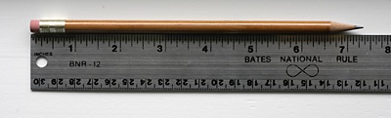
What is the length of the pencil?
© 2016 Pearson Education, Inc., Hoboken, NJ. All rights reserved.

Slide 9
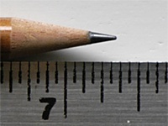
What is the length of the pencil?
© 2016 Pearson Education, Inc., Hoboken, NJ. All rights reserved.

Slide 10

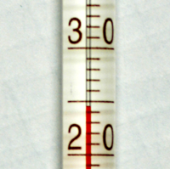
What is the temperature?
© 2016 Pearson Education, Inc., Hoboken, NJ. All rights reserved.

Slide 11

Analog Thermometer vs.
Digital Thermometer
analog thermometer
digital thermometer
© 2016 Pearson Education, Inc., Hoboken, NJ. All rights reserved.

Slide 12
Analog Scales vs. Digital Scales
© 2016 Pearson Education, Inc., Hoboken, NJ. All rights reserved.

Slide 13
What are the characteristics of digital readings?
© 2016 Pearson Education, Inc., Hoboken, NJ. All rights reserved.

Slide 14
Analog vs. Digital
Analog information
  continuous
  made up of infinite number of data points
Digital data
  discrete
© 2016 Pearson Education, Inc., Hoboken, NJ. All rights reserved.

Slide 15
Discrete Data
Examples:
number of persons
  There is no in-between one person and two persons.
choices in multiple-choice questions
  There is no in-between choice A and choice B.
© 2016 Pearson Education, Inc., Hoboken, NJ. All rights reserved.

Slide 16
Analog vs. Digital
Therometers and Scales
What are the limitations of these analog and digital devices?
What are the advantages of these analog and digital devices?
© 2016 Pearson Education, Inc., Hoboken, NJ. All rights reserved.

Slide 17
Analog vs. Digital
Sight and sound we peceive in our natural world are analog information--continuous and infinite number of points between any two points.
Computers handle discrete digital data. In addition, the amount of data has to be finite.
Sight and sound must be converted into finite discrete digital data in order for the computer to handle.
© 2016 Pearson Education, Inc., Hoboken, NJ. All rights reserved.

Slide 18
Before we talk about the conversion process, let's look at a scenario:
Monitoring a puppy's weight in his first year
© 2016 Pearson Education, Inc., Hoboken, NJ. All rights reserved.

Slide 19
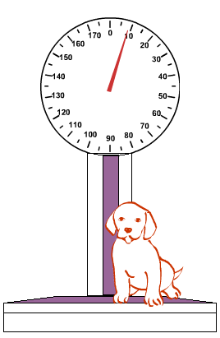
Suppose you use an analog scale to weigh the puppy
© 2016 Pearson Education, Inc., Hoboken, NJ. All rights reserved.

Slide 20
Now, what is the weight you would note down for this puppy?
© 2016 Pearson Education, Inc., Hoboken, NJ. All rights reserved.

Slide 21
See the problem in picking a number to represent an analog measurement?
© 2016 Pearson Education, Inc., Hoboken, NJ. All rights reserved.

Slide 22
Number of Decimal Places
In recording the weight, you must decide the number of decimal places to use.
This determines the precision or exactness of the measurement.
How many will give an exact measurement? How many is enough? How many is too many?
© 2016 Pearson Education, Inc., Hoboken, NJ. All rights reserved.

Slide 23
Using More Decimal Places
Pros :
  increase the precision in general
  (But how many is meaningful?)
  Will allow finer distinction between values
  (will explain in the next slide)
Cons:
  Require more paper and paperwork.
  Take longer to read through and interpret the numbers.
© 2016 Pearson Education, Inc., Hoboken, NJ. All rights reserved.

Slide 24
Distinction Between Values
With one decimal place:
  You can have 10 different values between say 2 and 3:
  2.1, 2.2, ...3.0
You can distinct between 2.5 and 2.8.
But 2.5 and 2.8 would have been rounded to the same value of 3 the values do not allow decimal places.
© 2016 Pearson Education, Inc., Hoboken, NJ. All rights reserved.

Slide 25
Distinction Between Values
Suppose the allowable weight read outs are these 10 levels:
0, 5, 10, 15, 20, 25, 30, 35, 40, 45
Then,
2 pounds: rounded to 0 pound
3 pounds: rounded to 5 pounds
The difference between 2 and 3 pounds is 1 pound.
But now, it become 5 pounds if we use these levels.
© 2016 Pearson Education, Inc., Hoboken, NJ. All rights reserved.

Slide 26
Now, how often would you weigh the puppy to produce a "good" monitoring of his weight over his first year?
once a year
once a month
every two weeks
every week
every day
every hour
every minute
every second
© 2016 Pearson Education, Inc., Hoboken, NJ. All rights reserved.

Slide 27
What are your considerations in deciding how often to weigh the puppy?
© 2016 Pearson Education, Inc., Hoboken, NJ. All rights reserved.

Slide 28
Considerations
What happens if you weigh the puppy not often enough?
What happens if you weigh the puppy too often?
Is there one right answer?
Will you use the same weighing schedule to monitor the weight of an adult dog?
© 2016 Pearson Education, Inc., Hoboken, NJ. All rights reserved.

Slide 29
DIGITIZATION:
SAMPLING AND QUANTIZATION
Back to the Computer
© 2016 Pearson Education, Inc., Hoboken, NJ. All rights reserved.

Slide 30
Digitization
To convert analog information into digital data that computers can handle
2-step process:
  sampling
  quantization
© 2016 Pearson Education, Inc., Hoboken, NJ. All rights reserved.

Slide 31
Sampling
Analogous to weighing and recording the puppy's weight
During the sampling step, you need to set a sampling rate.
Sampling rate: how often you take a data
© 2016 Pearson Education, Inc., Hoboken, NJ. All rights reserved.

Slide 32
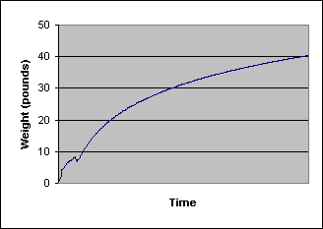
Suppose this is the true timeline of the puppy's first-year growth
© 2016 Pearson Education, Inc., Hoboken, NJ. All rights reserved.

Slide 33
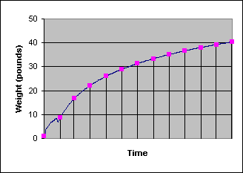
Suppose you weigh the puppy once a month
© 2016 Pearson Education, Inc., Hoboken, NJ. All rights reserved.

Slide 34
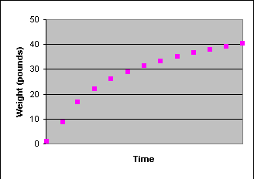
You get these data points
© 2016 Pearson Education, Inc., Hoboken, NJ. All rights reserved.

Slide 35
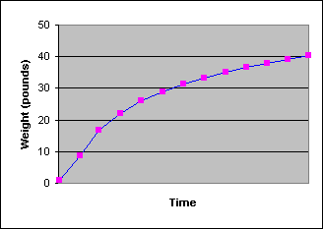
You then interpolate the points
© 2016 Pearson Education, Inc., Hoboken, NJ. All rights reserved.

Slide 36
You would miss the changes that occur during the first month
© 2016 Pearson Education, Inc., Hoboken, NJ. All rights reserved.

Slide 37
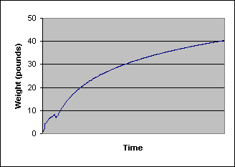
But the rest matches with the true growth pretty well
© 2016 Pearson Education, Inc., Hoboken, NJ. All rights reserved.

Slide 38
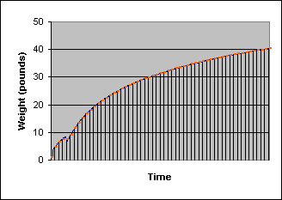
What about weighing the puppy once a week?
© 2016 Pearson Education, Inc., Hoboken, NJ. All rights reserved.

Slide 39
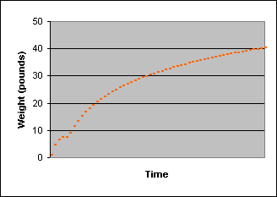
You get these data points
© 2016 Pearson Education, Inc., Hoboken, NJ. All rights reserved.

Slide 40
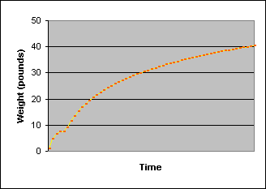
The data is catching the changes occurring in the first month better
© 2016 Pearson Education, Inc., Hoboken, NJ. All rights reserved.

Slide 41
But is it exactly?
© 2016 Pearson Education, Inc., Hoboken, NJ. All rights reserved.

Slide 42
Now for the rest of the year, the data points seem too many
© 2016 Pearson Education, Inc., Hoboken, NJ. All rights reserved.

Slide 43
Sampling Rate
 | Weighing Puppy Scenario | Digitization
high (i.e. taking data often) | Pros: can catch more weight changes Cons: produce more paperwork and thus take longer to read through all the data | Pros: can capture details (e.g. some changes of color within a small region in a picture or amplitude changes in sound within a short period of time) Cons: produce larger file and thus take longer to process
low (i.e. taking data infrequently) | Pros: less paperwork and thus take shorter time to read through all the data Cons: may miss weight changes | Pros: produce smaller file and thus take shorter time to process Cons: may miss details (e.g. color changes in a picture or changes in sound)
© 2016 Pearson Education, Inc., Hoboken, NJ. All rights reserved.

Slide 44
Quantization
Analogous to rounding the weight to fix number of digits in the weighing puppy scenario
During the quantization step, you need to set bit depth.
Bit depth refers to the number of allowable levels you map (or round) the values to.
© 2016 Pearson Education, Inc., Hoboken, NJ. All rights reserved.

Slide 45
Example: 10 levels of weight
For 10 discrete levels, you may have the 10 allowable values as
2.0, 2.1, 2.2, 2.3, 2.4, 2.5, 2.6, 2.7, 2.8, and 2.9
0, 5, 10, 15, 20, 25, 30, 35, 40, 45
2, 4, 6, 8, 10, 12, 14, 16, 18, 20
1, 2, 3, 4, 5, 6, 7, 8, 9, 10
... and so forth
© 2016 Pearson Education, Inc., Hoboken, NJ. All rights reserved.

Slide 46
Suppose you choose
2.0, 2.1, ..., 2.9
For 2.0, 2.1, 2.2, 2.3, 2.4, 2.5, 2.6, 2.7, 2.8, 2.9
Any weight data below 2.0 will be recorded as 2.0.
Any weight data higher than 2.9 will be capped at 2.9.
It works well if the puppy's weight falls in this range. But it does not seem to be the case.
© 2016 Pearson Education, Inc., Hoboken, NJ. All rights reserved.

Slide 47
Suppose you choose
0, 5,..., 45
For 0, 5, 10, 15, 20, 25, 30, 35, 40, 45
A weight of 2 pounds would be rounded to 0 and a weight of 3 pounds to 5.
Cons:
For example, the difference between 2 and 3 pounds is altered after they are mapped to the allowable value on this 10-level scale. The difference becomes 5 pounds not 1 pound.
Pros:
Wider range.
Again, it works well if the puppy's weight falls in this range.
© 2016 Pearson Education, Inc., Hoboken, NJ. All rights reserved.

Slide 48
Well, what if we choose this:
2.0, 2.1, 2.2, ..., 44.8, 44.9, 45.0
© 2016 Pearson Education, Inc., Hoboken, NJ. All rights reserved.

Slide 49
Suppose you choose
2.0, 2.1,...,44.9, 45.0
You have increased the number of levels from 10 to 431.
Pros:
  Increase precision compared to using
  0, 5, 10, 15, 20, 25, 30, 35, 40, 45
  Increase range compared to using
  2.0, 2.1, 2.2, 2.3, 2.4, 2.5, 2.6, 2.7, 2.8, 2.9
© 2016 Pearson Education, Inc., Hoboken, NJ. All rights reserved.

Slide 50
Increase Number of Allowable Levels
There does not seem to be any cons in the weighing puppy scenario.
However, for digitization, increasing the number of allowable levels (i.e. increasing bit depth) will increase the file size.
© 2016 Pearson Education, Inc., Hoboken, NJ. All rights reserved.

Slide 51
Sampling and Quantization
Digitizing media involves sampling and quantization regardless of the type of media:
  images
  video
  audio
© 2016 Pearson Education, Inc., Hoboken, NJ. All rights reserved.

Slide 52
Overview of how sampling rate and bit depth affect digital media file quality
 | Sampling rate is related to: | Bit depth is related to:
digital images | image resolution, or number of pixels | number of allowable colors in an image
digital video | number of pixels in the video, frame rate | number of allowable colors
digital audio | sampling rate of the audio (it limits how high the pitch of the audio can be captured) | number of allowable levels of amplitude
Details will be covered in chapters for each media type.
© 2016 Pearson Education, Inc., Hoboken, NJ. All rights reserved.

Slide 53
Review Questions
Note to instructor:
Depending on your preference, you may want to go over the review questions at the end of this lecture as an instant review or at the beginning of next lecture to refresh students' memory of this lecture.
© 2016 Pearson Education, Inc., Hoboken, NJ. All rights reserved.

Slide 54
Review Question
Digital data is _____ and analog information is _____.
A. continuous; discrete
B. discrete; continuous
© 2016 Pearson Education, Inc., Hoboken, NJ. All rights reserved.
Notes:
B

Slide 55
Review Question
Digitization means converting _____ into _____.
© 2016 Pearson Education, Inc., Hoboken, NJ. All rights reserved.
Notes:
analog information, digital data

Slide 56
Review Question
Converting from analog to digital involves a two-step process: _____ and _____.
© 2016 Pearson Education, Inc., Hoboken, NJ. All rights reserved.
Notes:
sampling, quantization

Slide 57
Review Question
When analog information is converted to digital data, two properties affect the exactness of the digital representation, one from sampling and one from quantizing. Which of the following is a result of quantization?
A. sampling rate
B. bit depth
© 2016 Pearson Education, Inc., Hoboken, NJ. All rights reserved.
Notes:
B

Slide 58
Review Question
Which of the following refers to the number of allowable levels of digitized data?
A. sampling rate
B. bit depth
© 2016 Pearson Education, Inc., Hoboken, NJ. All rights reserved.
Notes:
B

Slide 59
Review Question
Which of the following can reduce file size of digital media? (More than one choice)
A. decrease sampling rate
B. increase sampling rate
C. decrease bit depth
D. increase big depth
© 2016 Pearson Education, Inc., Hoboken, NJ. All rights reserved.
Notes:
A and C

Slide 60
"Digital Media Primer" Yue-Ling Wong,
Copyright (c)2016 by Pearson Education, Inc. All rights reserved.
© 2016 Pearson Education, Inc., Hoboken, NJ. All rights reserved.

Slide 61
Chapter 1
Background
Part 2
Bits basic concepts
© 2016 Pearson Education, Inc., Hoboken, NJ. All rights reserved.

Slide 62
In this lecture, you will find answers to these questions
What are bits?
What do encode and decode mean?
What is the significance of the number of bits?
© 2016 Pearson Education, Inc., Hoboken, NJ. All rights reserved.

Slide 63
Bits
In computer systems, data is stored and represented in binary digits, called bits.
To understand how bits can be used to store information, let's use eye signals as an analogy.
© 2016 Pearson Education, Inc., Hoboken, NJ. All rights reserved.

Slide 64
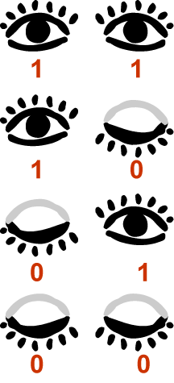
Two eyes, Four Combinations of Open and Closed
© 2016 Pearson Education, Inc., Hoboken, NJ. All rights reserved.

Slide 65
Encoding Your Eye Signals
To communicate with your friends with your eye signals, you will need to assign meanings (or messages) to the different combinations of open and closed eyes.
We call this process encoding the message.
© 2016 Pearson Education, Inc., Hoboken, NJ. All rights reserved.

Slide 66
Two eyes, Four Combinations of Open and Closed
You may assign a different meaning to each combination of open and close eyes.
© 2016 Pearson Education, Inc., Hoboken, NJ. All rights reserved.

Slide 67
Two eyes, Four Combinations of Open and Closed
You may assign "OMG" to this
© 2016 Pearson Education, Inc., Hoboken, NJ. All rights reserved.

Slide 68
Two eyes, Four Combinations of Open and Closed
You may assign "Yes" to this
© 2016 Pearson Education, Inc., Hoboken, NJ. All rights reserved.

Slide 69
Two eyes, Four Combinations of Open and Closed
You may assign "No" to this
© 2016 Pearson Education, Inc., Hoboken, NJ. All rights reserved.

Slide 70
Two eyes, Four Combinations of Open and Closed
You may assign "May be" to this
© 2016 Pearson Education, Inc., Hoboken, NJ. All rights reserved.

Slide 71
Two eyes, Four Combinations of Open and Closed
Or, in another situation,
You may assign nothing to this
You may assign "Like" to this
You may assign "Not Like" to this
You may assign nothing to this
© 2016 Pearson Education, Inc., Hoboken, NJ. All rights reserved.

Slide 72
Two eyes, Four Combinations of Open and Closed
Or, in yet another situation,
You may assign "red" to this
You may assign "black" to this
You may assign "blue" to this
You may assign "yellow" to this
© 2016 Pearson Education, Inc., Hoboken, NJ. All rights reserved.

Slide 73
Decode Your Eye Signals
In order to use your eye signals to communicate with your friends, they will need to know how to interpret your eye signals.
We call it decoding your eye signals.
© 2016 Pearson Education, Inc., Hoboken, NJ. All rights reserved.

Slide 74
Two eyes, Four Combinations of Open and Closed
No matter what messages, with 2 eyes, you can encode no more than 4 different messages.
© 2016 Pearson Education, Inc., Hoboken, NJ. All rights reserved.

Slide 75
How many eyes do you need if you have 16 possible colors to signal to your friends?
© 2016 Pearson Education, Inc., Hoboken, NJ. All rights reserved.
Notes:
4 eyes

Slide 76
Hand Signals
Suppose we consider only two possible poses for each finger: raised up or bent down.
How many different messages can you encode with 10 fingers?
© 2016 Pearson Education, Inc., Hoboken, NJ. All rights reserved.
Notes:
2¹⁰ = 1024

Slide 77
NOW RETURNING TO BITS
© 2016 Pearson Education, Inc., Hoboken, NJ. All rights reserved.

Slide 78
Bits
In computer systems, data is stored and represented in binary digits, called bits.
A bit has two possible values, 0 or 1.
© 2016 Pearson Education, Inc., Hoboken, NJ. All rights reserved.

Slide 79
Recall Our Eye Signals
Say, we give the open eye a 1 and the closed eye a 0.
We can think of each eye is a bit.
© 2016 Pearson Education, Inc., Hoboken, NJ. All rights reserved.

Slide 80
Recall Our Eye Signals
Say, we give the open eye a 1 and the closed eye a 0.
We can think of each eye is a bit.
We can think of our 2-eye signal system is a 2-bit system.
As you see, 2-bit system can encode 4 messages (or choices of things.)
© 2016 Pearson Education, Inc., Hoboken, NJ. All rights reserved.

Slide 81
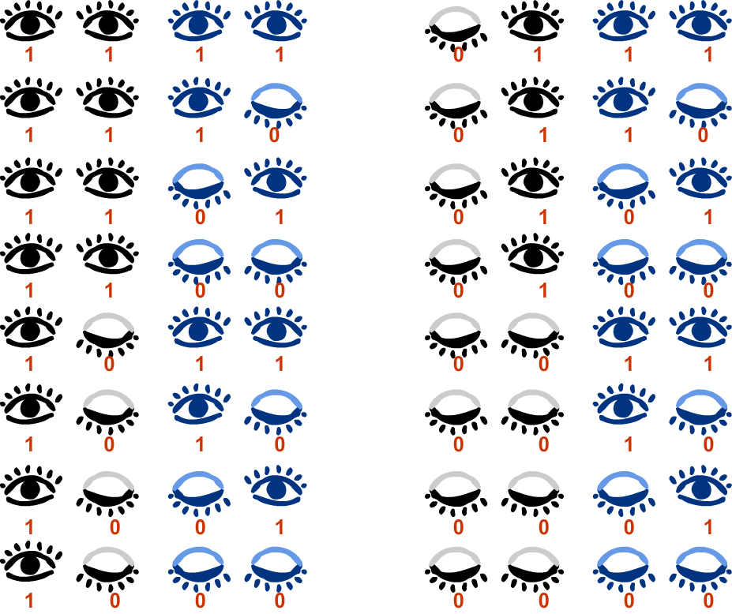
4 bits can encode 16 (2⁴) different messages
© 2016 Pearson Education, Inc., Hoboken, NJ. All rights reserved.

Slide 82
Number of possible values = 2^{(number of bits)}
More bits can encode more information.
More bits require more computer storage.
© 2016 Pearson Education, Inc., Hoboken, NJ. All rights reserved.

Slide 83
Bytes
1 byte = 8 bits
© 2016 Pearson Education, Inc., Hoboken, NJ. All rights reserved.

Slide 84
So Many Bits...
The number of bits to encode information especially for digital media are very large.
We use prefixes, such as mega and giga, to better conceive the number of bits and bytes of computer storage.
© 2016 Pearson Education, Inc., Hoboken, NJ. All rights reserved.

Slide 85
Prefixes
Prefix Name | Abbreviation | Size
Kilo | K | 2¹⁰ = 1,024
Mega | M | 2²⁰ = 2,048
Giga | G | 2³⁰ = 1,073,741,824
Tera | T | 2⁴⁰ = 1,099,511,627,776
Peta | P | 2⁵⁰ = 1,125,899,906,842,624
Note the size is computed by the exponential of 2.
The exponent is increased in a step of 10,
i.e. 2¹⁰ , 2²⁰ , 2³⁰ , 2⁴⁰ , 2⁵⁰ , ...
It is NOT 10³ , 10⁶ , 10⁹ , 10¹² , 10¹⁵ , ...
© 2016 Pearson Education, Inc., Hoboken, NJ. All rights reserved.

Slide 86
Review Questions
Note to instructor:
Depending on your preference, you may want to go over the review questions at the end of this lecture as an instant review or at the beginning of next lecture to refresh students' memory of this lecture.
© 2016 Pearson Education, Inc., Hoboken, NJ. All rights reserved.

Slide 87
Review Question
The word bit comes from the shortening of the words _____ _____.
© 2016 Pearson Education, Inc., Hoboken, NJ. All rights reserved.
Notes:
binary digit

Slide 88
Review Question
The smallest unit in a binary system is a _____.
A. bit
B. byte
© 2016 Pearson Education, Inc., Hoboken, NJ. All rights reserved.
Notes:
A

Slide 89
Review Question
A bit has these two possible values: _____ and _____.
© 2016 Pearson Education, Inc., Hoboken, NJ. All rights reserved.
Notes:
0, 1

Slide 90
Review Question
Eight _____ equals one _____.
A. bytes; bit
B. bits; byte
© 2016 Pearson Education, Inc., Hoboken, NJ. All rights reserved.
Notes:
B

Slide 91
Review Question
If you want to use hand signals to communicate only two possibilities—like or not like—to your friend, what is the minimum number of finger(s) you need? _____
We can call this hand-signal system ___-bit.
© 2016 Pearson Education, Inc., Hoboken, NJ. All rights reserved.
Notes:
1, 1

Slide 92
Review Question
If you want to encode only 2 colors, what is the minimum number of bit(s) you need? _____
© 2016 Pearson Education, Inc., Hoboken, NJ. All rights reserved.
Notes:
1

Slide 93
Review Question
If you want to encode only 8 colors, what is the minimum number of bit(s) you need? _____
© 2016 Pearson Education, Inc., Hoboken, NJ. All rights reserved.
Notes:
3

Slide 94
Review Question
Most grayscale images use 8-bit color. This means there can be _____ possible different gray tones in the image.
© 2016 Pearson Education, Inc., Hoboken, NJ. All rights reserved.
Notes:
256 or 2⁸

Slide 95
Review Question
(i) How many number of bits in this binary notation?
0011010
(ii) How many possible values can these many bits represent?
© 2016 Pearson Education, Inc., Hoboken, NJ. All rights reserved.
Notes:
(i) 7 bits
(ii) 2⁷ = 128

Slide 96
Review Question
Which of the following sizes is the largest?
A. 24 GB
B. 24 MB
C. 240 MB
D. 2400 KB
© 2016 Pearson Education, Inc., Hoboken, NJ. All rights reserved.
Notes:
A

Slide 97
"Digital Media Primer" Yue-Ling Wong,
Copyright (c)2016 by Pearson Education, Inc. All rights reserved.
© 2016 Pearson Education, Inc., Hoboken, NJ. All rights reserved.

Slide 98
Chapter 1
Background
Part 3
How bits represent information
© 2016 Pearson Education, Inc., Hoboken, NJ. All rights reserved.

Slide 99
In this lecture, you will find answers to these questions
How do bits represent digital media information?
© 2016 Pearson Education, Inc., Hoboken, NJ. All rights reserved.

Slide 100
REVIEW: BITS
© 2016 Pearson Education, Inc., Hoboken, NJ. All rights reserved.

Slide 101
Review
In computer systems, data is stored and represented in binary digits, called bits.
We use eyes in the eye signals as an analogy.
© 2016 Pearson Education, Inc., Hoboken, NJ. All rights reserved.

Slide 102
Two eyes, Four Combinations of Open and Closed
© 2016 Pearson Education, Inc., Hoboken, NJ. All rights reserved.

Slide 103
Encoding and Decoding Your Eye Signals
To communicate with your friends with your eye signals, you will need to assign meanings (or messages) to the different combinations of open and closed eyes--encoding the message.
In order to use your eye signals to communicate with your friends, they will need to know how to interpret your eye signals--decoding your eye signals.
© 2016 Pearson Education, Inc., Hoboken, NJ. All rights reserved.

Slide 104
Two eyes, Four Combinations of Open and Closed
You may assign a different meaning to each combination of open and close eyes.
© 2016 Pearson Education, Inc., Hoboken, NJ. All rights reserved.

Slide 105
Two eyes, Four Combinations of Open and Closed
You may assign "red" to this
You may assign "black" to this
You may assign "blue" to this
You may assign "yellow" to this
© 2016 Pearson Education, Inc., Hoboken, NJ. All rights reserved.

Slide 106
Bits
In computer systems, data is stored and represented in binary digits, called bits.
A bit has two possible values, 0 or 1.
© 2016 Pearson Education, Inc., Hoboken, NJ. All rights reserved.

Slide 107
Recall Our Eye Signals
Say, we give the open eye a 1 and the closed eye a 0.
We can think of each eye is a bit.
We can think of our 2-eye signal system is a 2-bit system.
As you see, 2-bit system can encode 4 messages (or choices of things.)
© 2016 Pearson Education, Inc., Hoboken, NJ. All rights reserved.

Slide 108
Number of possible values = 2^{(number of bits)}
More bits can encode more information.
More bits require more computer storage.
© 2016 Pearson Education, Inc., Hoboken, NJ. All rights reserved.

Slide 109
DONE REVIEW: BITS
© 2016 Pearson Education, Inc., Hoboken, NJ. All rights reserved.

Slide 110
Using bits to represent numeric values
Base-10 and Base-2 Conversion
© 2016 Pearson Education, Inc., Hoboken, NJ. All rights reserved.

Slide 111
Decimal Notation
Base-10
Commonly used in our daily life
Use combinations of 10 different numerals to construct any values
The 10 different numerals are:
  0, 1, 2, 3, 4, 5, 6, 7, 8, 9
© 2016 Pearson Education, Inc., Hoboken, NJ. All rights reserved.

Slide 112
Base-10 Example
The decimal number 5872 is interpreted as follows.
5
0
0
0
8
0
0
7
0
+
2
5
8
7
2
© 2016 Pearson Education, Inc., Hoboken, NJ. All rights reserved.

Slide 113
Base-10 Example
In other words,
5
8
7
2
=
5
x 10³ +
8
x 10² +
7
x 10¹ +
2
x 10⁰
=
5
x 1000 +
8
x 100 +
7
x 10 +
2
x 1
=
5
000 +
8
7
00 +
0 +
2
=
5
8
7
2
© 2016 Pearson Education, Inc., Hoboken, NJ. All rights reserved.

Slide 114
Binary Notation
Base-2
Used in machine language (language that computers understand)
Use combinations of 2 different numerals to construct any values
The 2different numerals are:
  0, 1
© 2016 Pearson Education, Inc., Hoboken, NJ. All rights reserved.

Slide 115
Base-2 Example
The binary notation 1011 is interpreted as follows.
1
0
1
1
=
1
x 2³ +
0
x 2² +
1
x 2¹ +
1
x 2⁰
=
1
x 8 +
0
x 4 +
1
x 2 +
1
x 1
=
8
+
0
2
+
+
1
=
11 (eleven, in decimal notation)
© 2016 Pearson Education, Inc., Hoboken, NJ. All rights reserved.

Slide 116
Base-2 to Base-10
The previous slide shows the base-2 to base-10 conversion method.
1101₂ (one one zero one) represents 11₁₀ (eleven).
The subscript indicates the base.
© 2016 Pearson Education, Inc., Hoboken, NJ. All rights reserved.

Slide 117
Base-10 to Base-2
To convert base-10 to base-2 notation:
repeatedly divide the decimal number by 2 until it becomes 0, noting the remainder of each division.
The reverse order of the sequence of the remainders is the binary representation of the decimal number.
© 2016 Pearson Education, Inc., Hoboken, NJ. All rights reserved.

Slide 118
Base-10 to Base-2 Example
To convert 19₁₀ to binary notation:
19 / 2 = 9 remainder 1
9 / 2 = 4 remainder 1
4 / 2 = 2 remainder 0
2 / 2 = 1 remainder 0
1 / 2 = 0 remainder 1
© 2016 Pearson Education, Inc., Hoboken, NJ. All rights reserved.

Slide 119
Base-10 to Base-2 Example
To convert 19₁₀ to binary notation:
19 / 2 = 9 remainder 1
9 / 2 = 4 remainder 1
4 / 2 = 2 remainder 0
2 / 2 = 1 remainder 0
1 / 2 = 0 remainder 1
10011₂
© 2016 Pearson Education, Inc., Hoboken, NJ. All rights reserved.

Slide 120
Examples
Decimal | Binary
0 | 0
1 | 1
2 | 10
3 | 11
4 | 100
5 | 101
6 | 110
7 | 111
© 2016 Pearson Education, Inc., Hoboken, NJ. All rights reserved.

Slide 121
Using bits to represent text
By assigning unique numbers to each text character
© 2016 Pearson Education, Inc., Hoboken, NJ. All rights reserved.

Slide 122
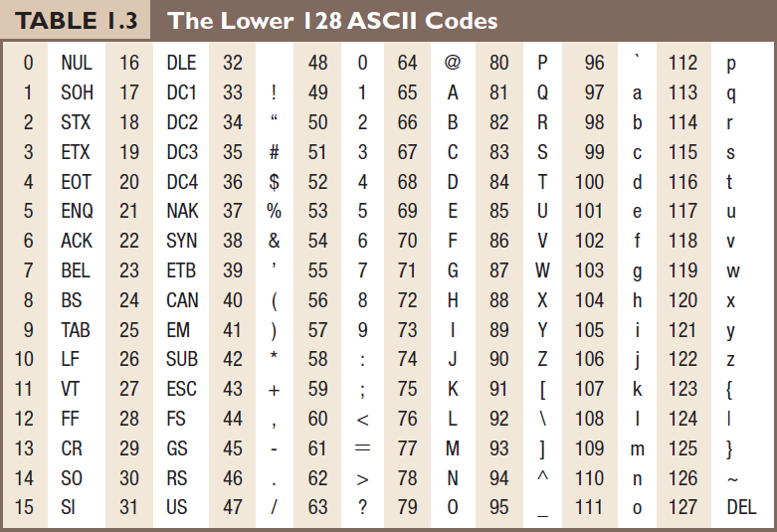
For example, the character A is represented by 65.
© 2016 Pearson Education, Inc., Hoboken, NJ. All rights reserved.

Slide 123
ASCII
stands for American Standard Code for Information Interchange
an encoding standard for text characters, including the 26-letter English alphabets and symbols in computer programs.
© 2016 Pearson Education, Inc., Hoboken, NJ. All rights reserved.

Slide 124
ASCII
For ASCII character set, each character uses 8 bits.
With 8 bits, you can encode 2⁸ = 256 different characters.
© 2016 Pearson Education, Inc., Hoboken, NJ. All rights reserved.

Slide 125
Unicode
another standard for encoding text character
can represent a large repertoire of multilingual characters
use more than 8 bits to encode a text character because multilingual character sets are larger than the ASCII set
© 2016 Pearson Education, Inc., Hoboken, NJ. All rights reserved.

Slide 126
Using bits to represent images
© 2016 Pearson Education, Inc., Hoboken, NJ. All rights reserved.

Slide 127
Using bits to represent images
Bitmap images, such as digital photos
  color value of each pixel encoded into bits
Vector graphics, such as graphics created in Flash
  coordinates of anchor points encoded into bits
  tangent of each anchor points encoded into bits
Bitmap images, vector graphics, and pixels will be explained in the digital images chapters
© 2016 Pearson Education, Inc., Hoboken, NJ. All rights reserved.

Slide 128
Using bits to represent sound
© 2016 Pearson Education, Inc., Hoboken, NJ. All rights reserved.

Slide 129
Using bits to represent sound
sampled audio
  amplitude for each sample encoded into bits
  For CD quality audio, it has 44,100 samples per second of the audio
MIDI music
  each musical instrument has an ID which can be encoded into bits
  each musical note has an ID which can be encoded into bits
Sampled audio and MIDI will be explained in the audio chapters
© 2016 Pearson Education, Inc., Hoboken, NJ. All rights reserved.

Slide 130
Using bits to represent program instructions
By using a sequence of bits to represent an operation
© 2016 Pearson Education, Inc., Hoboken, NJ. All rights reserved.

Slide 131
Using bits to represent program instructions
For example, an arithmetic addition may be represented by a sequence of bits:
001100
© 2016 Pearson Education, Inc., Hoboken, NJ. All rights reserved.

Slide 132
File Sizes
In a text document that uses ASCII code to represent text characters, each byte stores an ASCII code that corresponds to a character.
The more characters in a text document, the more bytes are required to store the file.
Digital media files (image, sound, and especially video files) can be very large.
© 2016 Pearson Education, Inc., Hoboken, NJ. All rights reserved.

Slide 133
Disadvantages of Large File Size
take longer to copy the file from one computer to another
take longer to send the file over the Internet
take longer to process (such as during opening and saving) the file
© 2016 Pearson Education, Inc., Hoboken, NJ. All rights reserved.

Slide 134
Strategies to Reduce Digital Media File Size
Reduce the sampling rate
Reduce the bit depth
Apply file compression
© 2016 Pearson Education, Inc., Hoboken, NJ. All rights reserved.

Slide 135
Reduce Sampling Rate
Recall the weighing puppy scenario
If you weigh the puppy more frequently, it will take more paper.
For digital media files, higher sampling rate means more data to store.
In other words, lower sample rate will produce less data, i.e. smaller file size.
© 2016 Pearson Education, Inc., Hoboken, NJ. All rights reserved.

Slide 136
Reduce Bit Depth
Bit depth refers to the number of allowable levels you can map the data
For digital media files, lower bit depth means less data to store.
© 2016 Pearson Education, Inc., Hoboken, NJ. All rights reserved.

Slide 137
Compression
File compression means techniques to reduce file size
Two categories in terms of whether the data get lost during the compression:
  lossy compression
  lossless compression
© 2016 Pearson Education, Inc., Hoboken, NJ. All rights reserved.

Slide 138
Lossy Compression
Some data will be lost and cannot be recovered
Examples:
  JPEG compression for images
  MP3 for audio
  most compressors for videos
© 2016 Pearson Education, Inc., Hoboken, NJ. All rights reserved.

Slide 139
Lossy Compression
Avoid using lossy compression (if possible) when you want to keep the file for further editing.
Generally, you can do so with images and audio.
Video files are generally so large that it is inevitable to save them with lossy compression.
© 2016 Pearson Education, Inc., Hoboken, NJ. All rights reserved.

Slide 140
Trade-offs of Reducing File Size
Data will be lost or altered when you apply these strategies:
reduce sampling rate
reduce bit depth
apply lossy compression
When data is lost or altered, you sacrifice the exactness of the media original information. This affects the quality of the media.
© 2016 Pearson Education, Inc., Hoboken, NJ. All rights reserved.

Slide 141
Weighing the Trade-offs
Depend on projects and intended use of the files
Weigh the file size (storage requirement and speed of transfer and processing of the file) against the quality of the digital media files
Losing data vs. "perceivable" quality
  Sometimes it may be acceptable if losing data does not cause "perceivable" deterioration in quality
© 2016 Pearson Education, Inc., Hoboken, NJ. All rights reserved.

Slide 142
Example: MP3
MP3 audio uses a lossy compression.
It reduces the file size by selectively removing and altering the audio data (such as certain ranges of audio frequencies) that are not very perceivable by human.
© 2016 Pearson Education, Inc., Hoboken, NJ. All rights reserved.

Slide 143
Review Questions
Note to instructor:
Depending on your preference, you may want to go over the review questions at the end of this lecture as an instant review or at the beginning of next lecture to refresh students' memory of this lecture.
© 2016 Pearson Education, Inc., Hoboken, NJ. All rights reserved.

Slide 144
Review Question
Our everyday decimal numbering system is base-_____. Computers use base-_____ , which is also known as the _____ numbering system.
© 2016 Pearson Education, Inc., Hoboken, NJ. All rights reserved.
Notes:
10, 2, binary

Slide 145
Review Question
This is a quote from a T-shirt:
"There are only 10 types of people in the world:
Those who understand binary and those who don't."
How many types does this quote actually mean?
(Hint: It is talking in binary!)
© 2016 Pearson Education, Inc., Hoboken, NJ. All rights reserved.
Notes:
two because 10₂ = 2₁₀

Slide 146
Review Question
(i) Name three general strategies to reduce the size of a digital media file.
(ii) Which of these strategies does not necessarily sacrifice the quality of the media file?
© 2016 Pearson Education, Inc., Hoboken, NJ. All rights reserved.
Notes:
(i) reduce sampling rate, reduce bit-depth, apply compression
(ii) lossless compression

Slide 147
Review Question
In general, if you want to keep a digital media file for further editing, you should _____.
A. avoid applying lossy compression
B. avoid applying lossless compression
© 2016 Pearson Education, Inc., Hoboken, NJ. All rights reserved.
Notes:
A

Slide 148
Chapter 1
Background
Part 4
Cloud Computing and Its Effects on Digial Media Workflow
© 2016 Pearson Education, Inc., Hoboken, NJ. All rights reserved.

Slide 149
In this lecture, you will find answers to these questions
What is cloud computing?
How is cloud computing different from the traditional desktop computing model?
How does cloud computing affect the way we work with digital media files?
© 2016 Pearson Education, Inc., Hoboken, NJ. All rights reserved.

Slide 150
Cloud Computing
Cloud:
  a large group of interconnected computers accessible via the Internet
Cloud computing:
  a computing model in which software applications and files are hosted on a cloud
© 2016 Pearson Education, Inc., Hoboken, NJ. All rights reserved.

Slide 151
Cloud Computing vs. Traditional Desktop Computing Model
Cloud Computing Model
Traditional Desktop Computing Model
Software applications and files are hosted on the cloud via the Internet.
Your documents are stored on the cloud and you can access them via Internet anywhere regardless of which device you use.
You install and run copies of software programs on your personal computer.
Your documents are stored on your personal computer
© 2016 Pearson Education, Inc., Hoboken, NJ. All rights reserved.

Slide 152
Three Service Models of Cloud Computing
Software as a Service (SaaS)
Platform as a Service (PaaS)
Infrastructure as a Service (IaaS)
© 2016 Pearson Education, Inc., Hoboken, NJ. All rights reserved.

Slide 153
Software as a Service (SaaS)
Allows users to run software applications on the cloud via their devices
Examples:
  Web-based email
  Google Calendar
  mobile apps that access the services
© 2016 Pearson Education, Inc., Hoboken, NJ. All rights reserved.

Slide 154
Platform as a Service (PaaS)
Allows users (usually software developers) to deploy onto the cloud their applications, which may be created or acquired by them, using programming languages, libraries, and tools that are supported by the cloud provider
Examples:
  Oracle Database Cloud Service
  Google App Engine
© 2016 Pearson Education, Inc., Hoboken, NJ. All rights reserved.

Slide 155
Infrastructure as a Service (IaaS)
Provides computing resources, such as computing processing, storage, and networks, for users (typically businesses) to deploy and run arbitrary software applications
Examples:
  Amazon EC2
  Google Compute Engine
© 2016 Pearson Education, Inc., Hoboken, NJ. All rights reserved.

Slide 156
Effects of Cloud Computing on Digital Media Workflow of Teams
Cloud Computing
Traditional Desktop Computing Model
Changes can only be made by one team member at a time.
Team members can access and modify documents by simultaneously on the cloud, making collaboration more efficient and instantaneous
© 2016 Pearson Education, Inc., Hoboken, NJ. All rights reserved.

Slide 157
Effects of Cloud Computing on Digital Media Delivery/Sharing
Cloud Computing
Traditional Desktop Computing Model
Digital media files are shared online.
Digital media applications are deployed as Web services.
Requires Internet access and prefers fast connection.
Digital media files and applications are delivered on optical discs.
Does not rely on Internet connection
© 2016 Pearson Education, Inc., Hoboken, NJ. All rights reserved.

Slide 158
Review Questions
Note to instructor:
Depending on your preference, you may want to go over the review questions at the end of this lecture as an instant review or at the beginning of next lecture to refresh students' memory of this lecture.
© 2016 Pearson Education, Inc., Hoboken, NJ. All rights reserved.

Slide 159
Review Question
Cloud refers to a large group of ___ accessible via the ___.
© 2016 Pearson Education, Inc., Hoboken, NJ. All rights reserved.
Notes:
interconnected computers, Internet

Slide 160
Review Question
In the computing model, what are the software applications and files hosted?
© 2016 Pearson Education, Inc., Hoboken, NJ. All rights reserved.
Notes:
on a cloud

Slide 161
Review Question
Multiple Choice:
In the ___ computing model, your software applications are installed locally on your personal computer and your files are saved on your personal computer.
cloud
traditional desktop
© 2016 Pearson Education, Inc., Hoboken, NJ. All rights reserved.
Notes:
B

Slide 162
Review Question
Multiple Choice:
In the ___ computing model, you share files using optical discs, such as DVD and CD. However, in the ___ computing model, you share files via the Internet.
cloud; traditional desktop
traditional desktop; cloud
© 2016 Pearson Education, Inc., Hoboken, NJ. All rights reserved.
Notes:
B

Slide 163
Review Question
True/False:
Google Calendar is an example of Cloud computing services.
© 2016 Pearson Education, Inc., Hoboken, NJ. All rights reserved.
Notes:
10, 2, binary

Slide 164
"Digital Media Primer" Yue-Ling Wong,
Copyright (c)2013 by Pearson Education, Inc. All rights reserved.

Slide 165
Chapter 2
Fundamentals of Digital Imaging
Part 1
Digitizing Images

Slide 166
In this lecture, you will find answers to these questions
What does digitizing images mean?
How are images sampled and quantized in the digitization process?
How are pixels, image resolution, and bit depth related to sampling and quantizing?
How do the choices of the sampling rate and bit depth affect the image fidelity and details?

Slide 167
Recall: Digitization
To convert analog information into digital data that computers can handle
2-step process:
  sampling
  quantization

Slide 168
Pegboard Analogy

Slide 169

Pegboard Analogy
A 10 holes ×10 holes pegboard

Slide 170

Pegboard Analogy
Suppose you want to copy this music not graphic on the pegboard.

Slide 171

Pegboard Analogy
Place one peg.

Slide 172

Pegboard Analogy
2 pegs.

Slide 173

Pegboard Analogy
3 pegs.

Slide 174

Pegboard Analogy
Suppose we only put peg in a hole if more than half of its area is covered by the musical note graphic.

Slide 175
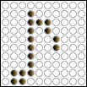
Pegboard Analogy
Now remove the musical note overlay.

Slide 176
Pegboard Analogy
Details are lost because the grid
is too coarse for this musical note.

Slide 177
How would you improve the details of the musical notes on the pegboard?

Slide 178

Using a pegboard with more holes

Slide 179

Using a pegboard with more holes
Now it looks closer to the original musical note.

Slide 180
Pixels
Each peg hole on the pegboard is a sample point.
The sample points are discrete.
In digital imaging, each of these discrete sample points is called a picture element, or pixel for short.

Slide 181
Pixel Dimensions
Refer to an image’s width and height in pixels
In the pegboard analogy, the dimension of this pegboard would be 10 holes × 10 holes.

Slide 182

Sampling Step

Slide 183
Let's look at the sampling step of digitizing a natural scene as if we are taking a digital photo of a natural scene.

Slide 184
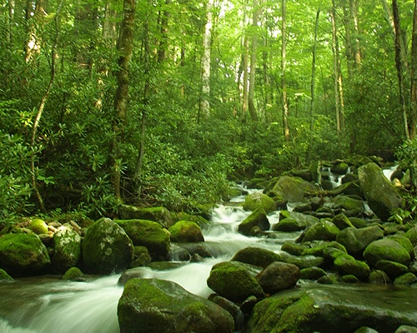
A natural scene
Look up and let your eyes fall on the scene in front of you. Draw an
imaginary rectangle around what you see. This is your “viewfinder.”
Imagine that you are going to capture this view on a pegboard.

Slide 185
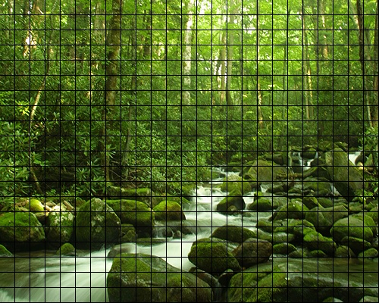
Sample into a grid of 25 × 20 discrete samples
Suppose you are going to sample the scene you see in the "viewfinder" into a pegboard with 25 × 20 holes.

Slide 186

One color for each peg hole.
Each peg hole takes only one peg. Suppose each peg has one solid color. Suppose the color of each of these discrete samples is determined by averaging the corresponding area.

Slide 187
This sampled image looks blocky. Details are lost because the grid is too coarse for this image.

Slide 188
For 25 × 20 sample points, it means you get a digitized image of 25 × 20 pixels.

Slide 189
Let's try a different grid size.

Slide 190
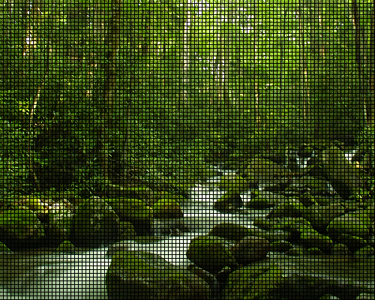
Sample into a grid of 100 × 80 discrete samples
Suppose you are going to sample the scene you see in the "viewfinder" into a pegboard with 100 × 80 holes.

Slide 191

Again, one color for each peg hole.

Slide 192

For 100 × 80 sample points, it means you get a digitized image of 100 × 80 pixels.

Slide 193
Sampling Rate
Refers to how frequent you take a sample
For an image, sampling frequency refers to how close neighboring samples are in a 2-D image plane.

Slide 194
Sampling Rate
For example, when we change the grid from 25 × 20 to 100 × 80, we say that we increase the sampling rate.
  You are sampling more frequently within the same spatial distance.

Slide 195
Resolution
In digital imaging, increasing the sampling rate is equivalent to increasing the image resolution.

Slide 196
Consequences of Higher Resolution
With higher resolution,
You have more sample points (pixels) to represent the same scene, i.e., the pixel dimensions of the captured image are increased.
The file size of the digitized image is larger.
You gain more detail from the original scene.

Slide 197
Resolution of Digital Photos
Note that 25 × 20 and 100 × 80 pixels are by no means realistic pixel dimensions in digital photography.
They are only for illustration purposes here. Most digital cameras can capture images in the range of thousand pixels in each dimension—for example, 3000 pixels × 2000 pixels.

Slide 198
A Pixel is not a Square Block
A pixel is a sample point.
It does not really have a physical dimension associated with it.

Slide 199
A Pixel is not a Square Block
When you zoom in on a digital image in an image editing program, you often see the pixels represented as little square blocks.
This is simply an on-screen representation of a sample point of an digitized image.

Slide 200
Colors

Slide 201
Problems
A natural image is colored in continuous tones, and thus it theoretically has an infinite number of colors.
The discrete and finite language of the computer restricts the reproduction of an infinite number of colors and shades.

Slide 202
Quantization Step
To encode an infinite number of colors and shades with a finite list.
Quantizing the sampled image involves mapping the color of each pixel to a discrete and precise value.

Slide 203
Quantization Step
First, you need to consider how many possible colors you want to use in the image.
To illustrate this process, let’s return to the example of the 100 × 80 sampled image.

Slide 204
The sampled 100 × 80 image

Slide 205
Say, we want to map the color of each sample points into one of these four colors:

Slide 206

Quantized with 4 Colors

Slide 207

Quantized with 8 Colors

Slide 208
Consequences of Quantization
Reduce the number of allowed colors in the image.
When we reduce the colors, different colors from the original may bemapped to the same color on the palette. This causes the loss of the image fidelity and details.
The details that rely on the subtle color differences are lost during quantization.

Slide 209
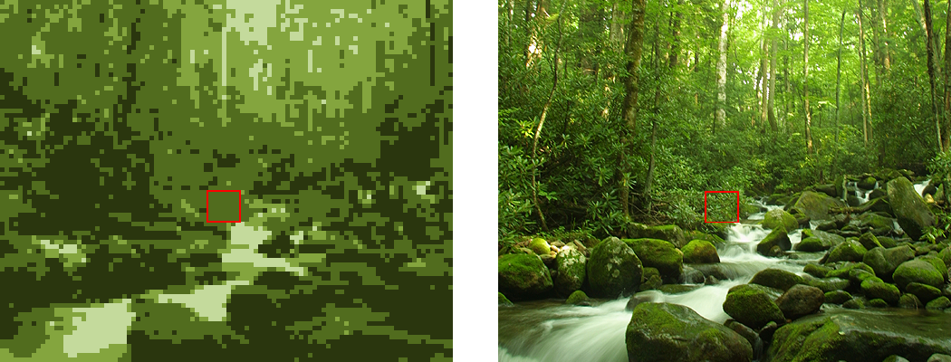
The same area in the 4-color image now has only one color.
The area outlined in red is made up of many different green colors.

Slide 210
Bit Depth
The number of colors used for quantization is related to the color depth or bit depth of the digital image.
A bit depth of n allows 2^{n} different colors. Examples:
  A 2-bit digital image allows 2² (i.e., 4) colors in the image.
  An 8-bit digital image allows 2⁸ (i.e., 256) colors in the image.
The most common bit depth is 24. A 24-bit image allows 2²⁴ (i.e., 16,777,216) colors.

Slide 211
Will increasing the number of colors in the palette improve the image fidelity?
It depends, and in most cases, can be yes.
The number of colors or the bit depth is not the only determining factor for image fidelity in quantizing an image.
The choice of colors for the quantization also plays an important role in the reproduction of an image.

Slide 212

Quantized with 8 Different Colors

Slide 213
Effect of Bit Depth on File Size
Higher bit depth means more bits to represent a color.
Thus, an image with a higher bit depth has a larger file size than the same image with a lower bit depth.

Slide 214
Review Questions
Note to instructor:
Depending on your preference, you may want to go over the review questions at the end of this lecture as an instant review or at the beginning of next lecture to refresh students' memory of this lecture.

Slide 215
Review Question
Recall that the process of converting from analog to digital information is a 2-step process--sampling and quantizing. In capturing an analog image to a digital image, the sampling rate affects ___.
A. the bit depth of the resulting digital image
B. the pixel dimensions of the resulting digital image
Notes:
B

Slide 216
Review Question
In the quantization step, to capture an analog image to a digital image, ___.
A. a 2-dimensional grid is applied on the image and each tiny cell on the grid is converted into a pixel
B. a 2-dimensional grid is applied on the image to apply dithering to the image
C. an infinite number of color shades and tones in an analog image is mapped to a set of discrete color values
D. the resulting digital image file is compressed to have a smaller file size
Notes:
C

Slide 217
Review Question
Which of the following factors will increase the file size of a digital image?
A. larger pixel dimensions of the image
B. higher color depth
Notes:
both A and B

Slide 218
Review Question
A digital image captured at a higher resolution ___.
A. captures more details than the same image stored at a lower resolution
B. represents more colors than the same image stored at a lower resolution
C. has greater bit depth than the same image stored at a lower resolution
D. has a larger file size than the same image stored at a lower resolution
E. has larger pixel dimension than the same image stored at a lower resolution
Notes:
A, D, and E

Slide 219
Review Question
If a digital image captured at a higher resolution, ___than it would have been captured at a lower resolution.
A. it has larger pixel dimensions
B. it has a higher bit depth
C. it has more different colors
D. it has a larger file size
E. the sampling step uses a higher sampling rate
Notes:
A, D, and E

Slide 220
Review Question
If a digital image has a higher bit depth, ___than it would have been at a lower bit depth.
A. it has larger pixel dimensions
B. it has more different colors
C. it has a larger file size
D. a higher sampling rate is used
Notes:
B and C

Slide 221
Review Question
The term “pixel” is contracted from the words ___ ___.
Notes:
picture element

Slide 222
Review Question
True/False: A pixel is a point sample, not a little square.
Notes:
true

Slide 223
Review Question
True/False: An 1-bit color depth allows only 2 colors.
Notes:
true

Slide 224
Review Question
True/False: An 1-bit color depth allows only black and white colors.
Notes:
false

Slide 225
Review Question
An 8-bit color depth allows ___ colors,
Notes:
2⁸ = 256

Slide 226
Review Question
An 24-bit color depth allows ___ colors,
Notes:
2²⁴

Slide 227
"Digital Media Primer" Yue-Ling Wong,
Copyright (c)2013 by Pearson Education, Inc. All rights reserved.

Slide 228
Chapter 2
Fundamentals of Digital Imaging
Part 2
Bitmapped Images vs.
Vector Graphics

Slide 229
In this lecture, you will find answers to these questions
What are bitmap images?
What are vector graphics?
What do aliasing and anti-aliasing mean?

Slide 230
Bitmapped images
Examples:
Web images, e.g. JPEG, PNG, GIF
Adobe Photoshop images

Slide 231
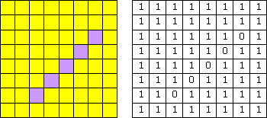
Bitmapped images
Characteristics
the image is divided in a grid (think of it as a pegboard)
each cell (think of it as a peghole) in the grid stores only one color value (think of it as a peg)
each cell is called a pixel—picture element
bitmap images are resolution dependent; each image has a fixed resolution
the level of details the image can represent depends on the number these cells, or pixels.
A pegboard with more holes lets you create a picture with finer details.
cells

Slide 232
Bitmapped images
If I specify "1" to represent yellow and "0" to represent purple,
the data to describe this image is:
1111111111111111111111011111101111110111111011111101111111111111
The size of the data (the file size) in this example—an 8x8-pixel image is not too bad, but what about we have a 3000x2000-pixel—an image from a 6-megapixel digital camera?

Slide 233
Bitmap vs. Pixmap
Bitmap: In certain contexts, it refers to images with 1 bit per pixel, i.e., each pixel has a value either 0 or 1.
Pixmap: If each pixel has a color value that uses more than 1 bit.
Here we are using the term bitmap or bitmapped images to refer to all pixel-based images.

Slide 234
Vector Graphics
Examples: graphics created in
  Adobe Flash
  Adobe Illustrator

Slide 235
Vector Graphics
Characteristics
Generated mathematically,
i.e. instructions
not pixel-based
Resolution independent

Slide 236
Vector Graphics Instruction Example
A simple postscript example:
  %!
  newpath
  200 200 moveto
  300 200 lineto
  stroke
  showpage

Slide 237
Bitmap Images vs.
Vector Graphics
An analogy:
  Driving Directions:
  A visual map vs. a written instruction
Bitmap ~~> map
Vector Graphics ~~> a written instruction

Slide 238
Bitmap Images vs.
Vector Graphics
An analogy:
  Driving Directions:
  A visual Triptik map vs. a written instruction
Which one takes up more storage space?
  Triptik map ~~> bitmap
Which one takes you more time to translate the direction into a mental image?
  written instruction ~~> vector graphics (take more computation to display on computer because it is mathematically generated)

Slide 239
Bitmap Images vs.
Vector Graphics
An analogy:
  Driving Directions:
  A visual Triptik map vs. a written instruction
If you are going to draw out a map based on a written instruction, how big can you draw?
  as big as you physically can ~~> the instruction is resolution independent

Slide 240
Bitmap Images vs.
Vector Graphics
1111111111111111111111011111101111110111111011111101111111111111
  %!
  newpath
  2 1 moveto
  6 5 lineto
  stroke
  showpage
vector graphic
bitmap image

Slide 241
Vector Graphics
The unit is arbituary, i.e. when you print out an image, you may set one unit as an inch or a foot.
This means vector graphic is resolution independent.
  %!
  newpath
  2 1 moveto
  6 5 lineto
  stroke
  showpage
vector graphic

Slide 242
Printing Bitmap Images
have the same amount of data, i.e. same level of details
print bigger
print smaller
bitmap image

Slide 243
Printing Vector Graphics
print bigger
print smaller
vector graphics

Slide 244
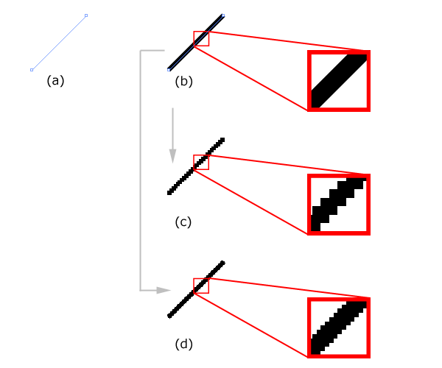
Bitmap Images vs. Vector Graphics
Example
Vector graphics:A line defined by two end points.
Vector graphics: The same line is stroked with a certain width.
& (d) The line is converted to a bitmap.

Slide 245
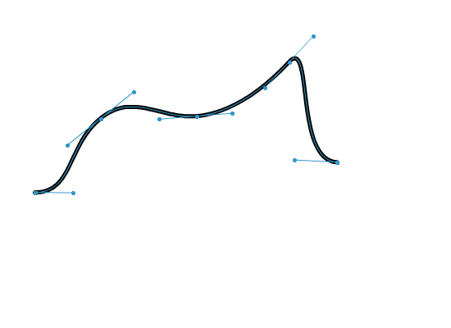
Curve Drawing in Vector Graphics Programs
defined by a set of points;
we call them anchor points
the direction handles or tangent handles of a point controls the tangent at that point on the curve

Slide 246
Rastering Vector Graphics
Raster means convert vector graphics into pixel-based images.
Most vector graphics programs let you rasterize vector graphics.
Need to specify a resolution for rasterizing, that is, how coarse or how fine the sampling.

Slide 247
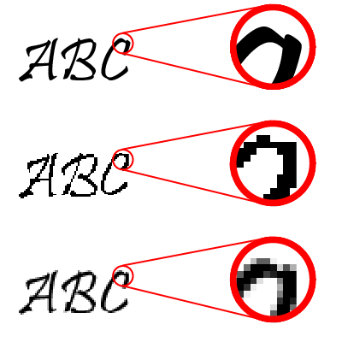
Aliasing
The rasterized image will appear jagged.
This jagged effect is a form of aliasing caused by undersampling (which means insufficient sampling rate.) Recall the musical note on a pegboard example.
Original vector graphics
Rastered vector graphics without anti-aliasing

Slide 248
Anti-aliasing Techniques
To soften the jaggedness by coloring the pixels with intermediary shades in the areas where the sharp color changes occur.
Original vector graphics
Rastered vector graphics without anti-aliasing
Rastered vector graphics with anti-aliasing

Slide 249
Review Questions
Note to instructor:
Depending on your preference, you may want to go over the review questions at the end of this lecture as an instant review or at the beginning of next lecture to refresh students' memory of this lecture.

Slide 250
Review Question
Bitmapped images are composed of ___.
A. individual pixels which represent spatial samples of the image or scene
B. mathematical descriptions of image elements which include points, lines, curves, and figures
Notes:
A

Slide 251
Review Question
Vector graphics are composed of ___.
A. individual pixels which represent spatial samples of the image or scene
B. mathematical descriptions of image elements which include points, lines, curves, and figures
Notes:
B

Slide 252
Review Question
The main advantage(s) of bitmapped images over vector graphics is (are) ___.
A. scalability (ie., resolution independence of images)
B. ease of editing the image content pixel by pixel
C. more compact file size compared to vector graphics
Notes:
B

Slide 253
Review Question
The main advantage(s) of vector graphics over bitmapped images is (are) ___.
A. scalability (ie., resolution independence of images)
B. ease of editing the image content pixel by pixel
C. more compact file size compared to vector graphics
Notes:
A and C

Slide 254
Review Question
Sometimes when you magnify a picture on your computer screen, lines that should be straight lines appear to be jagged. This effect is called ___.
A. anti-aliasing
B. aliasing
C. dithering
D. indexing
Notes:
B

Slide 255
Fundamentals of Digital Imaging
Part 5
File Size and File Compression

Slide 256
In this lecture, you will find answers to these questions
How do pixel dimensions affect the image file size?
How does the bit-depth affect the image file size?
Why should JPEG files NOT be used as working files for further editing?

Slide 257
Why Compression?
higher resolution or higher bit depth ⇒ larger file size
Without compression, image files would take up an unreasonable amount of disk space.
Larger files take longer time to transfer over the network.

Slide 258
How many bits?
Let’s look at the size of a typical high resolution image file without compression.

Slide 259
How many bits?
Suppose 6-megapixel digital camera may produce digital images of 3000 × 2000 pixels in 24-bit color depth.
Total pixels:
3000 × 2000 pixels = 6,000,000 pixels
File size in bits:
6,000,000 pixels × 24 bits/pixel = 144,000,000 bits
File size in bytes:
144,000,000 bits / (8 bits/byte) = 18,000,000 bytes ≅ 17 MB

Slide 260
Strategies To Reduce File Sizes
Reducing the pixel dimensions
Lowering the bit depth (color depth)
Compress the file

Slide 261
Reducing Pixel Dimensions
Capture the image at a lower resolution in the first place
Resample (resize) the existing image to a lower pixel dimensions

Slide 262
Reducing Pixel Dimensions
Returning to our calculation of the file size of an image of 3000 × 2000 pixels in 24-bit color depth.
Let's calculate the file size of an image of 1500 × 1000 pixels in 24-bit color depth.

Slide 263
How many bits if half the size in each pixel dimension?
Total pixels:
1500× 1000 pixels = 1,500,000 pixels
File size in bits:
1,500,000 pixels × 24 bits/pixel = 36,000,000 bits
File size in bytes:
36,000,000 bits / (8 bits/byte) = 4,500,000 bytes ≅ 4.3 MB
It's 1/4th of the file size.

Slide 264
Lowering the Bit Depth
Returning to our calculation of the file size of an image of 3000 × 2000 pixels in 24-bit color depth.
Let's calculate the file size of an image if we reduce the bit depth to 8-bit.

Slide 265
How many bits if reduced to 8-bit?
Total pixels:
3000 × 2000 pixels = 6,000,000 pixels
File size in bits:
6,000,000 pixels × 8 bits/pixel = 48,000,000 bits
File size in bytes:
48,000,000 bits / (8 bits/byte) = 6,000,000 bytes ≅ 5.7 MB
It's 1/3rd of the file size.

Slide 266
24-bit vs. 8-bit
24-bit:
2²⁴ (about 16 million) colors
8-bit:
2⁸ (about 256) colors

Slide 267
Weighing Bit Depth Against File Size
24-bit → 8-bit:
  You lose about 16 million colors!
  May cause image quality degradation.
But 8-bit will work well if your image does not need more than 256 colors.

Slide 268
24-bit → 8-bit Without Noticeable Image Quality Degradation
Grayscale images: e.g.
  scanned images of black-and-white photos
  hand-written notes (may be even lowered to 4-bit, 2-bit, or 1-bit)
Illustration graphics: e.g. poster or logo
  contains only a few colors as large areas of solid colors

Slide 269
File Compression Methods
File compression:
To reduce the size of a file by squeezing the same information into fewer bits.
Lossless compression method:
  e.g., TIFF, PNG, PSD
  No information is lost
  GIF files also use lossless compression but it limits the number of colors to 256
Lossy compression method:
  e.g., JPEG
  Some information is lost in the process.
  For digital media files, the information to be left out is chosen such that it is not the human sensory system most sensitive to.

Slide 270
Working with Lossy Compression
JPEG files:
  JPEG compression, which is lossy (i.e., the lost information cannot be recovered)
  Do not use JPEG files as working files for further editing
  Repeated saving a JPEG file will degrade the image quality further
  Save as JPEG only in the very last step of your editing process. For example, when you have finished editing the image and are ready to post it on the Web.
  Avoid using JPEG for images intended for high quality prints

Slide 271

An original TIFF image

Slide 272

A JPEG with a very low quality setting.
Note the ugly artifacts around the contrast edges.

Slide 273
Closeup view of the JPEG with a very low quality setting.
Note the blockiness and ugly artifacts around the contrast edges.

Slide 274
File Types During Editing or Capturing
PSD
PNG
TIFF
camera RAW

Slide 275
Common File Types of Pixel-based Images
File Type | File Suffix | Standard Color Modes | Use | Compression
JPEG (Joint Photographic Experts Group) | .jpg .jpeg | RGB CMYK | Best for continuous tone images such as photographs can be used for Web images | Lossy compression method called JPEG compression that works well with photographs

Slide 276
Common File Types of Pixel-based Images
File Type | File Suffix | Standard Color Modes | Use | Compression
GIF (Graphics Interchange Format) | .gif | Indexed color, grayscale | Supports up to 8-bit color Best for illustration graphics or cartoon-like pictures with large blocks of solid color and clear divisions between color areas a proprietary format of CompuServe can be used for Web images | Lossless compression method called LZW compression

Slide 277
Common File Types of Pixel-based Images
File Type | File Suffix | Standard Color Modes | Use | Compression
PNG (Portable Network Graphics) | .png | indexed, grayscale, black and white | Supports 8-bit and 24-bit color Can be used for Web images | Lossless compression

Slide 278
Common File Types of Pixel-based Images
File Type | File Suffix | Standard Color Modes | Use | Compression
TIFF (Tag Image File Format) | .tif .tiff | RGB, CMYK, CIE-Lab, indexed, grayscale, black and white | Proprietary format of Adobe Photoshop good for any types of digital images that Photoshop supports stores layers supports alpha channel | Lossless compression

Slide 279
Common File Types of Pixel-based Images
File Type | File Suffix | Standard Color Modes | Use | Compression
PSD (Photoshop Digital Image) | .psd | RGB, CMYK, CIE-Lab, indexed, grayscale, black and white | Supported on both Windows and Mac common file format supports alpha channel | Allows uncompressed, LZW compression (lossless), ZIP (lossless), JPEG (lossy)

Slide 280
Common File Types of Vector Graphics
File Type | File Suffix | Information and Use
Encapsulated PostScript | .eps | Standard file format for storing and exchanging files in professional printing
Adobe Illustrator file | .ai
Adobe Flash file | .fla .swf
Windows Metafile format | .wmf | Many cliparts from Microsoft Office are in this format
Enhanced Metafile format | .emf | Developed by Microsoft as a successor to .wmf

Slide 281
"Digital Media Primer" Yue-Ling Wong,
Copyright (c)2013 by Pearson Education, Inc. All rights reserved.

Slide 282
Chapter 2
Fundamentals of Digital Imaging
Part 4
Color Representation

Slide 283
In this lecture, you will find answers to these questions
What is RGB color model and how does it represent colors?
What is CMY color model and how does it represent colors?
What is HSB color model and how does it represent colors?
What is color gamut? What does out-of-gamut mean?
Why can't the colors on a printout match exactly what you see on screen?

Slide 284
Color Models
Used to describe colors numerically, usually in terms of varying amounts of primary colors.
Common color models:
  RGB
  CMYK
  HSB
  CIE and their variants.

Slide 285
RGB Color Model
Primary colors:
  red
  green
  blue
Additive Color System

Slide 286
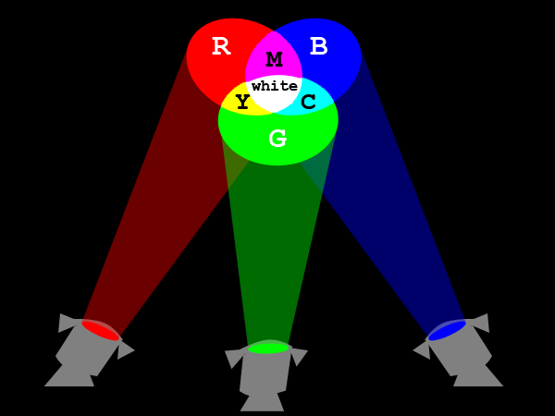
Additive Color System

Slide 287
Additive Color System of RGB
Full intensities of red + green + blue = white
Full intensities of red + green = yellow
Full intensities of green + blue = cyan
Full intensities of red + blue = magenta
Zero intensities of red, green, and blue = black
Same intensities of red, green, and blue = some kind of gray

Slide 288


Color Monitors
From a standard CRT monitor screen

Slide 289

Color Monitors
From a SONY Trinitron monitor screen

Slide 290

Color Monitors
From a LCD screen

Slide 291
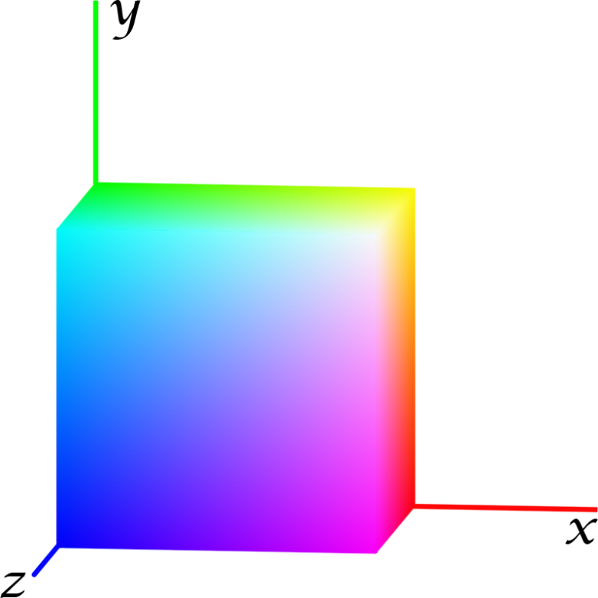
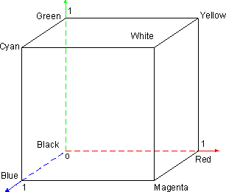
RGB Color Model
depicted graphically as a cube defined by three axes in 3-D space
The maximum value on eachaxis is normalized to 1.

Slide 292
RGB Color Model
x-axis: red values
y-axis: green values
z-axis: blue values

Slide 293
RGB Color Model
The coordinates within the color cube represent the relative intensities of red, green, and blue colors.

Slide 294
RGB Color Model
origin (0,0,0): black

Slide 295
RGB Color Model
(1,0,0): full intensity of red

Slide 296
RGB Color Model
(0,1,0): full intensity of green

Slide 297
RGB Color Model
(0,0,1): full intensity of blue

Slide 298
RGB Color Model
(1,1,1): white

Slide 299
RGB Color Model
(1,1,0): full red + full green = full yellow

Slide 300
RGB Color Model
(1,0,1): full red + full blue = full magenta

Slide 301
RGB Color Model
(0,1,1): full green+ full blue = full cyan

Slide 302
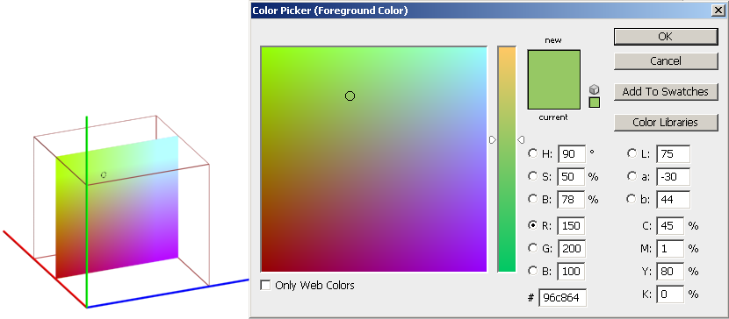
Color Picker
So where is the color whose RGB values are (150, 200, 100) in the RGB cube?

Slide 303
Correlating RGB Color Cube with Color Picker
This is a 2-D slice containing all the colors with red = 150.

Slide 304
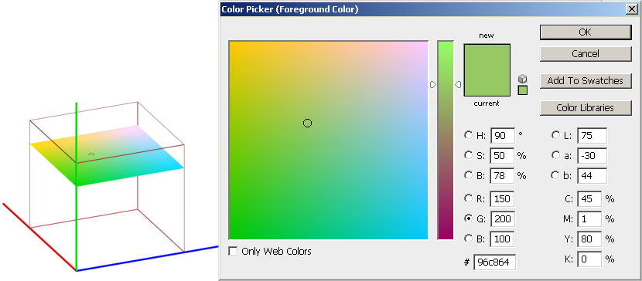
Correlating RGB Color Cube with Color Picker
This is a 2-D slice containing all the colors with green = 200.

Slide 305
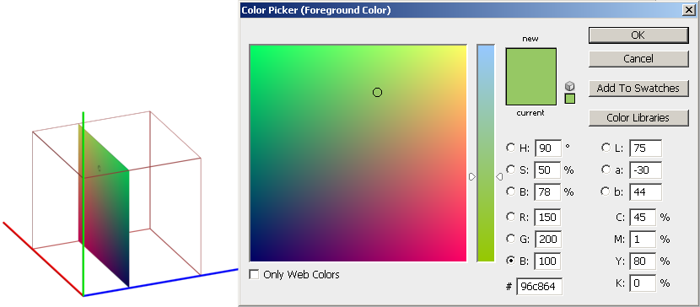
Correlating RGB Color Cube with Color Picker
This is a 2-D slice containing all the colors with blue = 100.

Slide 306
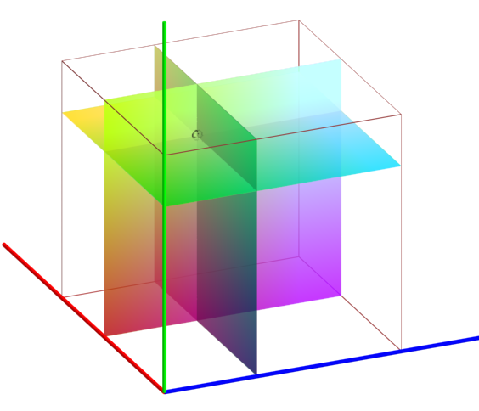
Correlating RGB Color Cube with Color Picker
The color (150, 200, 100) is located in the 3-D space of the RGB color cube.
It is at the intersection of the three 2-D slices.

Slide 307
CMYK Color Model
Primary colors:
  cyan
  magenta
  yellow
  black
Subtractive Color System

Slide 308
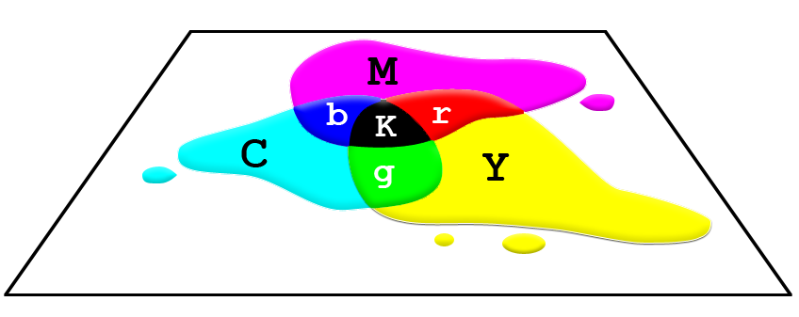
Subtractive Color System of CMY

Slide 309
Subtractive Color System of CMY
Full intensities of cyan + magenta + yellow = black (theoretically, but in practice with inks, it is not full black)
Full intensities of cyan + magenta = blue
Full intensities of cyan + yellow = green
Full intensities of magenta + yellow = red
Zero intensities of cyan, magenta, and yellow = white

Slide 310
HSB Color Model
Hue:
  basic color
  0º to 360º : the location on a color wheel
  in the order of colors in a rainbow
Saturation:
  purity of the color
  how far away from the neutral gray of the same brightness
Brightness

Slide 311
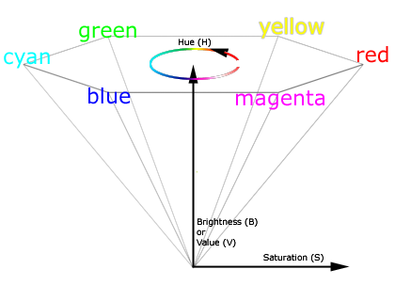
HSB Color Model

Slide 312
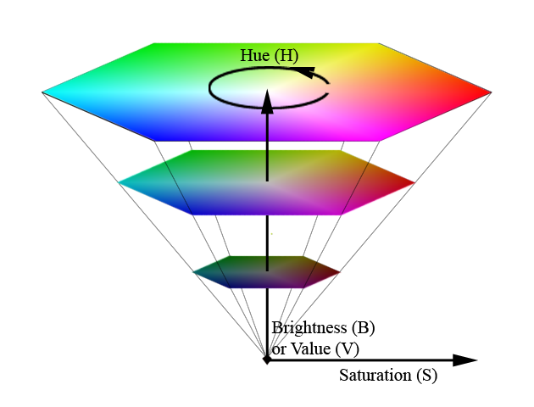
HSB Color Model

Slide 313

HSB Color Model
A slice of the color wheel from the HSB model

Slide 314
HSB Color Model
Matches well with the way humans intuitively think about colors
For example, how would you describe this color?
  Would you think of it in terms of how much red, green, and blue?
  Would you first think of it as a yellowish color and then figure out the lightness and how washed out the color is?

Slide 315
Problems with RGB and CMYK Color Space
Do not encompass all the colors human can see

Slide 316
CIE XYZ Color Model
Primaries:
  X
  Y
  Z
Primaries are not physical colors
Its color space encompasses all the colors human can see.
Normally not used in digital image editing because monitors and printers cannot reproduce all the colors in the CIE XYZ color space anyway.

Slide 317
Color Gamuts
Refers to the range of colors of a specific system or device can produce or capture

Slide 318
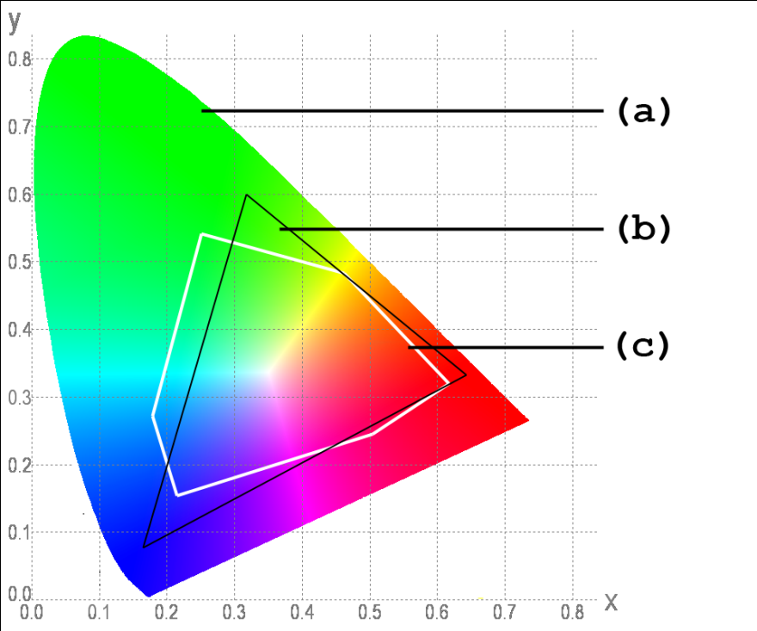
Color Gamuts
Colors that human can see
RGB color gamut of typical CRT monitors
CMYK color gamut of typical inkjet printers

Slide 319
Color Gamuts
Monitors and inkjet printers cannot reproduce all the colors that human can see
Some of the colors that monitors can reproduce cannot be reproduced by inkjet printers. Most of these colors lie at the corners of the color gamut of the monitor, which means these are highly saturated colors.

Slide 320
Identifying Out-of-Gamut Colors in Images
Out-of-gamut colors will not be printed correctly.
In digital image editing programs such as Adobe Photoshop, you can tell whether a color is out of gamut based on your CMYK setting.
Click on the icon to use the closest color in gamut for printing.

Slide 321
Identifying Out-of-Gamut Colors in Images
Out-of-gamut colors will not be printed correctly.
In digital image editing programs such as Adobe Photoshop, you can tell whether a color is out of gamut based on your CMYK setting.

Slide 322
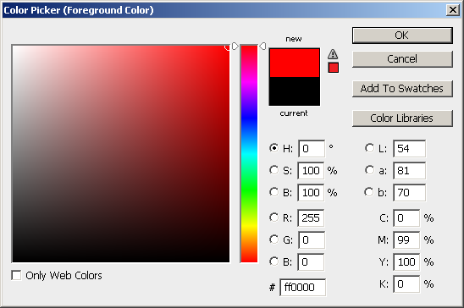
Identifying Out-of-Gamut Colors in Images

Slide 323
Identifying Out-of-Gamut Colors in Images
Click on the icon to replace the out-of-gamut color with the closest color in gamut for printing.

Slide 324
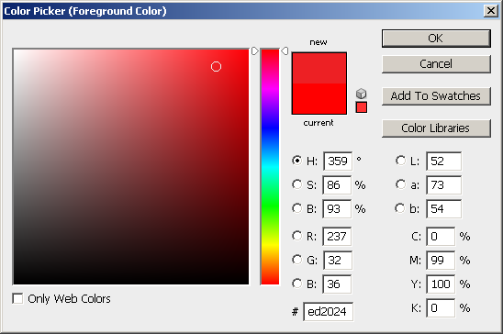
Identifying Out-of-Gamut Colors in Images
The out-of-gamut color is replaced with the closest color in gamut for printing.

Slide 325
Difficulties in Reproducing Colors in Digital Images
Digital devices cannot produce all of the colors visible to human
Difficulties exist in reproducing color across devices
  different devices have different color gamuts
  additive color system for screen display vs. subtractive color system for printing

Slide 326
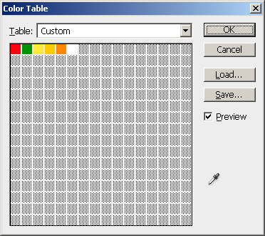

Indexed Color

Slide 327
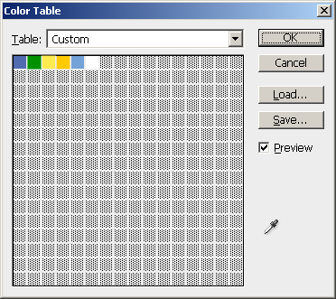

Indexed Color

Slide 328
Review Questions
Note to instructor:
Depending on your preference, you may want to go over the review questions at the end of this lecture as an instant review or at the beginning of next lecture to refresh students' memory of this lecture.

Slide 329
Review Question
What are the primary colors in the RGB color model?
Notes:
red, green, blue

Slide 330
Review Question
What are the primary colors in the CMY color model?
Notes:
cyan, magenta, yellow

Slide 331
Review Question
What are the primaries in the HSB color model?
Notes:
hue, saturation, brightness

Slide 332
Review Question
Which of the following color models take(s) the form of a color cube?
RGB
CMY
HSB
CIE XYZ
Notes:
A and B

Slide 333
Review Question
Which of the following color models take(s) the form of a hexacone?
RGB
CMY
HSB
CIE XYZ
Notes:
C

Slide 334
Review Question
Which of the primaries in the HSB color model takes the form of a color wheel?
Hue
Saturation
Brightness
Notes:
A

Slide 335
Review Question
What is the color mixing method for the RGB color model?
additive
subtractive
Notes:
cyan, magenta, yellow

Slide 336
Review Question
What is the color mixing method for the CMY color model?
additive
subtractive
Notes:
cyan, magenta, yellow

Slide 337
Review Question
What are the RGB values for white?
What are the CMY values for white?
Notes:
RGB: 255, 255, 255
CMY: 0%, 0%, 0%

Slide 338
Review Question
What are the RGB values for black?
What are the CMY values for black?
Notes:
RGB: 0, 0, 0
CMY: 100%, 100%, 100%

Slide 339
Review Question
What are the RGB values for red?
What are the CMY values for red?
Notes:
RGB: 255, 0, 0
CMY: 0%, 100%, 100%

Slide 340
Review Question
What are the RGB values for green?
What are the CMY values for green?
Notes:
RGB: 0, 255, 0
CMY: 100%, 0%, 100%

Slide 341
Review Question
What are the RGB values for blue?
What are the CMY values for blue?
Notes:
RGB: 0, 0, 255
CMY: 100%, 100%, 0%

Slide 342
Review Question
What are the RGB values for yellow?
What are the CMY values for yellow?
Notes:
RGB: 255, 255, 0
CMY: 0%, 0%, 100%

Slide 343
Review Question
Why don't the colors in the printed image look exactly the same as you see on computer screen?
Notes:
Digital devices have different color gamuts. Some colors that can be produce on screen cannot be produced by the printer.

Slide 344
"Digital Media Primer" Yue-Ling Wong,
Copyright (c)2013 by Pearson Education, Inc. All rights reserved.

Slide 345
Chapter 3
Capturing and Editing Digital Images
Capturing Images by Digital Photography

Slide 346
In this lecture, you will find answers to these questions
What does megapixel mean?
Does a digital camera with more megapixels always mean better image quality?
Does a digital camera with a higher megapixel rating give bigger prints?

Slide 347
Digital Cameras
point-and-shoot
D-SLR (digital single-lens reflex)
  Most D-SLR cameras use interchangeable-lenses

Slide 348
Digital Camera Sensors
Types
  CCD (charge coupled device)
  CMOS (complementary metal-oxide semiconductor)
The size of the sensor and the number of light-sensing sites determine the maximum resolution of the digital camera.

Slide 349
Megapixels
1 megapixel = 1,000,000 pixels

Slide 350
Megapixels Example
An image of 3000 × 2000 pixels has a total number of pixels of:
3000 × 2000 pixels = 6,000,000 pixels
= 6,000,000 pixels/1,000,000 pixels/megapixel
= 6 megapixels

Slide 351
Megapixels Example
An image of 1600 × 1200 pixels has a total number of pixels of:
1600 × 1200 pixels = 1,920,000 pixels
= 1,920,000 pixels/1,000,000 pixels/megapixel
= 1.92 megapixels
rounded up to 2 megapixels

Slide 352
Megapixels Example
An image of 1800× 1100 pixels has a total number of pixels of:
1800× 1100 pixels = 1,980,000 pixels
= 1,980,000 pixels/1,000,000 pixels/megapixel
= 1.98 megapixels
rounded up to 2 megapixels

Slide 353
Megapixels
Give an approximate number of total pixels in an image
Does not provide information about the aspect ratio (i.e., relative width and height) of the image

Slide 354
Does a digital camera with more megapixels mean better image quality?
No
Digital photo quality is determined by:
  the optics of the lens
  the size and quality of the sensor
  the camera electronics
  the camera’s image processing software

Slide 355
Does a digital camera with a higher megapixel rating give bigger prints?
The print size depends on the printing resolution.
Let's return to our megapixel examples:
  6-megapixel image: 3000 × 2000 pixels
  2-megapixel image: 1600 × 1200 pixels

Slide 356
Print Sizes of a 6-megapixel Image
Printed at 150 ppi:
3000 pixels / 150 ppi = 20"
2000 pixels / 150 ppi = 13.3"
Printed at 300 ppi:
3000 pixels / 300 ppi = 10"
2000 pixels / 300 ppi = 6.7"
Printed at 600 ppi:
3000 pixels / 600 ppi = 5"
2000 pixels / 600 ppi = 3.3"

Slide 357
Print Sizes of a 2-megapixel Image
Printed at 150 ppi:
1600 pixels / 150 ppi = 10.7"
1200 pixels / 150 ppi = 8"
Printed at 300 ppi:
1600 pixels / 300 ppi = 5.3"
1200 pixels / 300 ppi = 4"
Printed at 600 ppi:
1600 pixels / 600 ppi = 2.7"
1200 pixels / 600 ppi = 2"

Slide 358
Does a digital camera with a higher megapixel rating give bigger prints?
As you see in the examples:
With the same printing resolution, yes, images with more megapixels give bigger prints.
With different printing resolutions, the 2-megapixel image (printed at 150 ppi) gives a bigger print than the 6-megapixel image (printed at 300 ppi).

Slide 359
Review Questions
Note to instructor:
Depending on your preference, you may want to go over the review questions at the end of this lecture as an instant review or at the beginning of next lecture to refresh students' memory of this lecture.

Slide 360
Review Question
Name two methods you can capture digital images.
Notes:
scanning and digital photography

Slide 361
Review Question
1 megapixel = ___ pixels
Notes:
1,000,000

Slide 362
Review Question
An image of 6000 × 6000 pixels is said to have ___ megapixels.
Notes:
36

Slide 363
Review Question
Does a digital camera with more megapixels always mean better image quality?
Notes:
No

Slide 364
Review Question
What are the factors of digital cameras that determine the image quality?
Notes:
the optics of the lens
the size and quality of the sensor
the camera electronics
the camera’s image processing software

Slide 365
Review Question
Does a digital camera with a higher megapixel rating give bigger prints?
Notes:
No, it depends on the print resolution

Slide 366
"Digital Media Primer" Yue-Ling Wong,
Copyright (c)2013 by Pearson Education, Inc. All rights reserved.

Slide 367
Chapter 3
Capturing and Editing Digital Images
Part 6
Output Images for Print

Slide 368
In this lecture, you will learn:
how to estimate the print size based on the print resolution and the pixel dimensions of the image
how to estimate the print resolution based on the print size and the pixel dimensions of the image
how to estimate the pixel dimensions of the image based on the print size and the print resolution

Slide 369
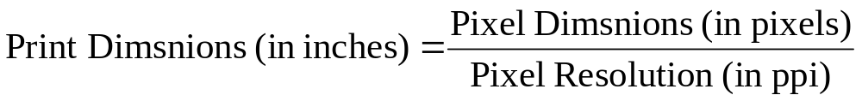
Print Size of an Image
Both the pixel dimensions of an image and the image resolution (ppi) affect the image’s print size.

Slide 370
Print Size of an Image
Both the pixel dimensions of an image and the image resolution (ppi) affect the image’s print size.
What this means that you can't determine the print size if you:
only know the pixel dimensions of an image without the print resolution (ppi)
only know the print resolution (ppi) without the pixel dimensions of an image

Slide 371
To better understand the equation, let's look at 3 scenarios and plug in some numbers.

Slide 372
Scenario 1:
Maintaining the Print Dimensions
To make an 8" x 4.5" print
Print Resolution (ppi) | Required Pixel Dimensions
100 ppi | width = 8" × 100 ppi = 800 pixels height = 4.5" × 100 ppi = 450 pixels
200 ppi | width = 8" × 200 ppi = 1600 pixels height = 4.5" × 200 ppi = 900 pixels
300 ppi | width = 8" × 300 ppi = 2400 pixels height = 4.5" × 300 ppi = 1350 pixels
With a fixed print size, you need larger pixel dimensions with a higher print ppi.

Slide 373
Scenario 2:
Maintaining the Pixel Dimensions
For an image of 1600 x 900 pixels
Print Resolution (ppi) | Resulted Print Size
100 ppi | width = 1600 pixels / 100 ppi = 16" height = 900 pixels / 100 ppi = 9"
200 ppi | width = 1600 pixels / 200 ppi = 8" height = 900 pixels / 200 ppi = 4.5"
300 ppi | width = 1600 pixels / 300 ppi = 5.3" height = 900 pixels / 300 ppi = 3"
With fixed pixel dimensions, you get a smaller print with a higher print ppi.

Slide 374
Scenario 3:
Maintaining the Print PPI
Suppose the print resolution is kept at 300 ppi
Print Size | Required Pixel Dimensions
5.3" × 3" | width = 5.3" × 300 ppi = 1600 pixels height = 3" × 300 ppi = 900 pixels
8" × 4.5" | width = 8" × 300 ppi = 2400 pixels height = 4.5" × 300 ppi = 1350 pixels
16" × 9" | width = 16" × 300 ppi = 4800 pixels height = 9" × 300 ppi = 2700 pixels
With a fixed print ppi, you need larger pixel dimensions for a larger print.

Slide 375
So, how are these scenarios translated into the settings used in an image-editing program?

Slide 376
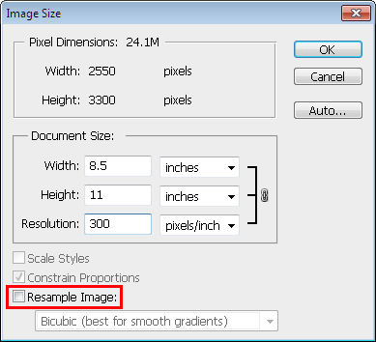
Adjust Output Resolution or Print Size in Photoshop:
Image > Image Size...
Scenario 2: Fixed pixel dimensions
You cannot change the pixel dimensions

Slide 377
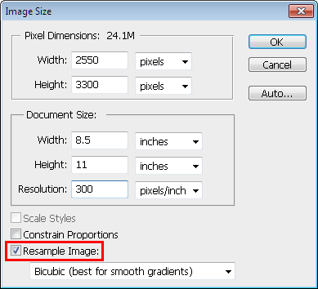
Adjust Output Resolution or Print Size in Photoshop:
Image > Image Size...
Scenario 1: Fixed Print Size
If you change the Resolution, the Pixel Dimensions will be updated automatically while keeping the print size fixed.

Slide 378
Adjust Output Resolution or Print Size in Photoshop:
Image > Image Size...
Scenario 3: Fixed Print Resolution (PPI)
If you change the Pixel Dimensions or Document Size, the other will be updated automatically while keeping the Resolution fixed.

Slide 379
Resample Image
With the Resample Image option on, the pixel dimensions can be varied.
Scaling the pixel dimensions of an image is referred to as resampling because the number of samples (pixels) is changed.

Slide 380
Effect of Resampling Image on Image Quality
Scaling an image usually deteriorates the image quality somewhat.
Scale down: You are removing pixels, i.e., the image will lose some details.
Scale up: Interpolation will be perform to fill in extra pixels. The resulted image will appear blurry.

Slide 381
Print Resolution PPI vs.
Printer Resolution DPI
Print Resolution PPI ≠ Printer Resolution DPI

Slide 382
Printer Resolution DPI
Number of ink dots per inch
Color inkjet printers produce a microscopic spray of ink which appears to be very tiny dots of ink.
These ink dots of different colors--but a limited number of colors--produce the required color by optical mixing.
The color of a single pixel of an image is represented by a group of printer dots.

Slide 383
Print PPI vs. Printer DPI
 | Increasing Print PPI | Increasing Printer DPI
Effect on print size | Depending on the scenario, the print size may decrease or maintain the same. | No
Effect on image quality | No | The color appears smoother on the print. However, higher dpi uses more ink and requires longer time to complete the print job

Slide 384

An interactive demonstration on optical color mixing
Also see the interactive tutorial:
OPTICAL COLOR MIXING IN POINTILLISM,
DITHERING, AND INKJET PRINTING

Slide 385
Review Questions
Note to instructor:
Depending on your preference, you may want to go over the review questions at the end of this lecture as an instant review or at the beginning of next lecture to refresh students' memory of this lecture.

Slide 386
Review Question
True/False: When a digital image is printed, each image pixel is represented by one printer ink dot.
Notes:
False

Slide 387
Review Question
Resampling an image is often referred to as ______ .
A. rotating
B. scaling
C. translating
D. repositioning
Notes:
B

Slide 388
Review Question
True/False: Resampling an image will have negative impact on the image quality.
Notes:
True

Slide 389
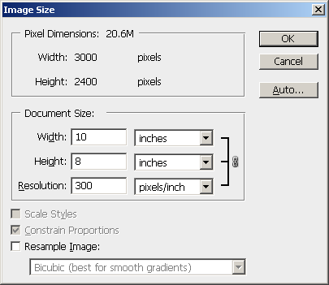
Review Question
The pixel dimensions of the image are ___ × ___.
Notes:
3000 x 2000 pixels

Slide 390
Review Question
The physical size of the image, if it is printed out is ___ × ___.
Notes:
10" x 8"

Slide 391
Review Question
The printing resolution of the image is ___.
Notes:
300 ppi

Slide 392
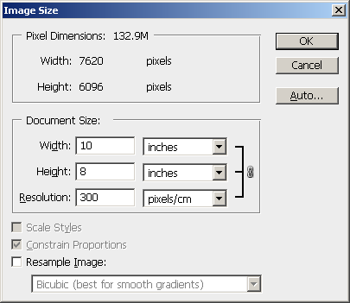
Review Question
The image should have the pixel dimensions 3000 × 2000 pixels. Identify the incorrect setting that causes such a discrepancy in pixel dimensions.
Notes:
The unit in the Resolution is set to pixels/cm; it should be pixels/inch.

Slide 393
Review Question
For the following questions, predict the new values in the Image Size window.

Slide 394
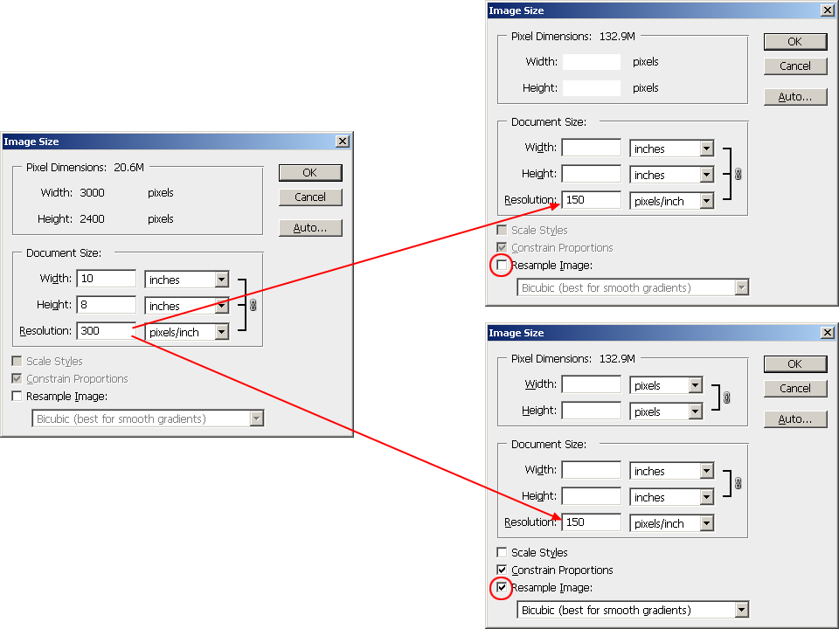

Slide 395
Answers
3000
2400
20
16
1500
1200
10
8

Slide 396
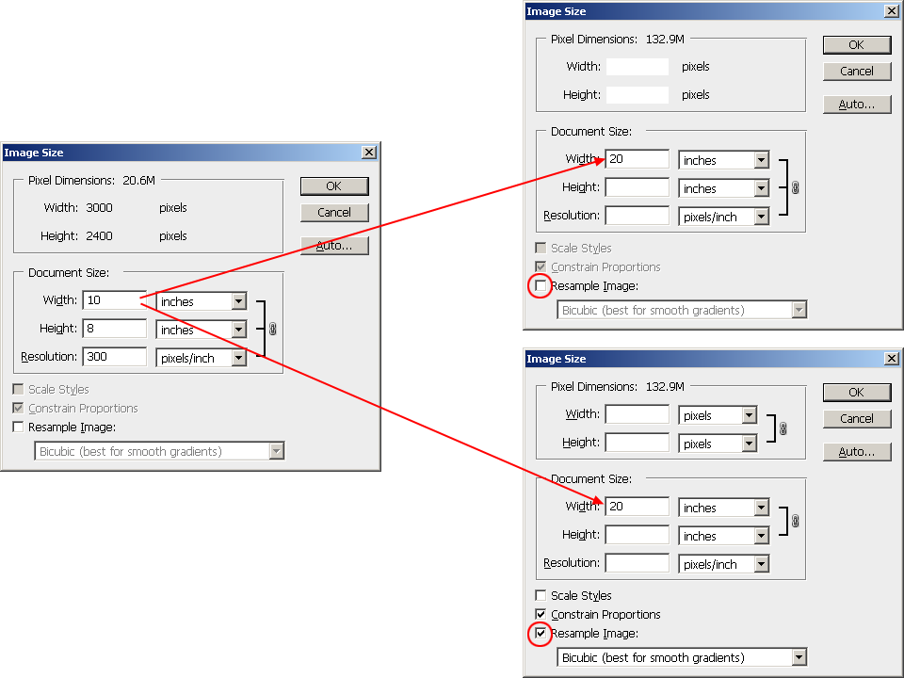

Slide 397
Answers
3000
2400
16
150
6000
2400
16
300

Slide 398
Review Question
Suppose you have created an image (with size information shown in the next slide) and you want to print it on a 10" × 8" paper with at least a half-inch margin all around. Fill in the correct image settings that can accomplish this task with the maximum printed area for the image without affecting the image quality.

Slide 399
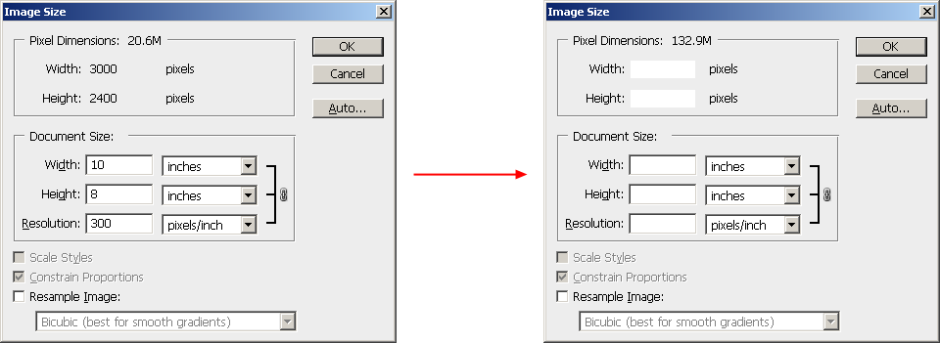

Slide 400
Answers
3000
2400
8.75
7
343
unchecked

Slide 401
"Digital Media Primer" Yue-Ling Wong,
Copyright (c)2013 by Pearson Education, Inc. All rights reserved.

Slide 402
Chapter 3
Capturing and Editing Digital Images
Part 7
Output Images for Web

Slide 403
In this lecture, you will learn:
the characteristics, pros, and cons of the common file formats for Web images
how to choose image file format for Web
what dithering means

Slide 404
Common File Formats for Web Images
JPEG
GIF
PNG

Slide 405
JPEG
best with:
  continuous-tone images with a broad color range
  subtle color and brightness variations
  e.g., photographs and images with gradients.
JPEG supports 24-bit color (millions of colors)
JPEG compression: lossy
(it loses image data in order to make the file size smaller)

Slide 406
JPEG
Does not work well with:
  solid colors
  A color solid is the three-dimensional representation of a color model, an analog of the two-dimensional color wheel. The added spatial dimension allows a color solid to depict an added dimension of color variation.
  contrast image
  contrast edges
Highly compressed JPEG images:
  blur the image detail
  show a visible artifact around the high contrast edges

Slide 407


JPEG Compression Artifacts
Original
Highly compressed JPEG
Note the ugly artifacts at the intersection between 2 colors.
The solid colors are not solid colors anymore.

Slide 408
GIF
most effective for images with solid colors such as illustrations, logos, and line art
Up to 8-bit color (256 colors)
supports background transparency
animated GIF

Slide 409
Color Reduction
GIF uses a palette of up to 256 colors to represent the image
Need to reduce the colors if the original image has more than 256 colors
Advantage:
Smaller file size after reducing number of colors (i.e., reducing bit-depth or color-depth)
(Recall that reducing bit-depth or color depth can reduce file size.)

Slide 410
Color Reduction
Determine which colors are in the palette. Options available in Photoshop
Perceptual
Selective
Adaptive
Restrictive
Custom

Slide 411

Example: Original TIF
(file size: 406 KB)

Slide 412

Example: GIF 256 colors, no dither
(file size: 28 KB)

Slide 413
Example: GIF 256 colors, no dithering
(file size: 28 KB)
Note the stripes in the gradient areas.
This is due to not enough colors.

Slide 414
Color Reduction
Undesirable effects
  stripes in smooth gradient areas
  some colors are altered (remapped to a different colors on the palette)
Use dithering to reduce the undesirable effects

Slide 415
Dithering
  A technique to simulate colors that are outside of the palette by using a pattern of like colored pixels.

Slide 416

Example: GIF 256 colors, with dithering
(file size: 34 KB)
The stripes in the gradient areas are less noticeable.

Slide 417


Without and With Dithering
Reduce the stripes effect
Smooth out the color transition

Slide 418
Without and With Dithering
Some colors are not solid anymore, but with dithering

Slide 419
PNG
PNG-8
  up to 256 colors (8-bit)
PNG-24
  24-bit colors
  lossless compression
  larger file size than JPEG but without the ugly JPEG compression artifacts

Slide 420
1. Hands-on to optimize files in JPEG, GIF, and PNG formats and to adjust the compression settings to achieve the balance between the file size and overall image quality.
2. Learn the type of images that each of these file formats is most effective at compressing.
Also try out the worksheet:
WORKSHEET: JPEG VERSUS GIF VERSUS PNG

Slide 421
Review Questions
Note to instructor:
Depending on your preference, you may want to go over the review questions at the end of this lecture as an instant review or at the beginning of next lecture to refresh students' memory of this lecture.

Slide 422
Review Question
What kind of images are GIF files most appropriate for?
A. big areas of solid colors
B. continuous tone photographs
C. lots of gradients
Notes:
A

Slide 423
Review Question
What kind of images are JPEG files most appropriate for?
A. big areas of solid colors
B. continuous tone photographs
C. lots of gradients
Notes:
B and C

Slide 424
Review Question
Which file format(s) can be created as an animated sequence?
A. JPEG
B. PNG
C. GIF
Notes:
C

Slide 425
Review Question
Which file format(s) can have transparency?
A. JPEG
B. PNG
C. GIF
Notes:
B and C

Slide 426
Review Question
Saving an image with more than 256 colors into a GIF may have the undesirable effects as discussed in the lecture.
So why or when would you want to save an image as a GIF?
Notes:
reduce file size
create an animated gif
background transparency (although PNG can have transparency)

Slide 427
Review Question
In general, a PNG-24 file has a larger file size than a JPEG.
So why or when would you want to save an image as a PNG instead of a JPEG?
Notes:
lossless compression (so you can keep it for further editing)
no ugly JPEG artifacts
an image that has contrast edges and solid colors (which JPEG does not work well with)

Slide 428
"Digital Media Primer" Yue-Ling Wong,
Copyright (c)2013 by Pearson Education, Inc. All rights reserved.

Slide 429
Chapter 3
Capturing and Editing Digital Images
Part 8
Vector Graphics

Slide 430
In this lecture, you will learn:
what make up a vector graphic object
what are paths, anchor points, direction handles, strokes, fills
the common tools to create and edit vector graphics
how to adjust the curviness and tangent of a path

Slide 431
Vector Graphics
Objects and shapes made up with paths, points, strokes and fills
Not pixel based

Slide 432
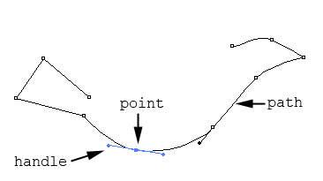
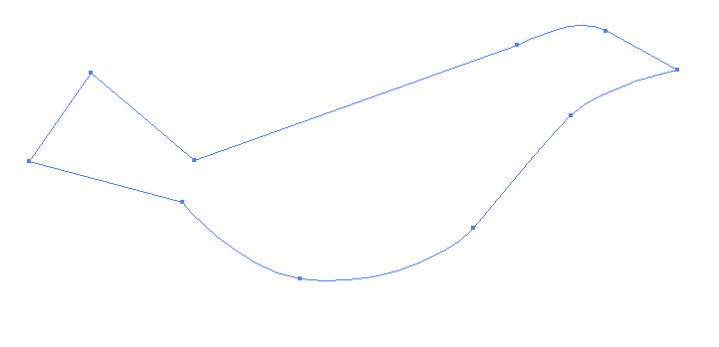
Paths
open path
closed path

Slide 433
Paths and Points
A mathematical description of an abstract line or curve
Defined by a set of points, called anchor points

Slide 434
Tangent and Curviness
Each point has direction handles or tangent handles.
Handle's angle: tangent at the point
Handle's length: curviness at the point

Slide 435
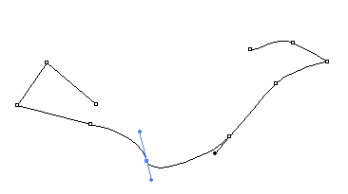
Angle of Handle: Tangent

Slide 436


Length of Handle: Curviness
Longer handle
Curvier at the point
Shorter handle
More angular at the point

Slide 437
Corner Points vs. Smooth Points
Corner point:
  appears sharp and angular
  handles have zero length
  used for creating straight segments
  In vector graphic programs, a corner point does not have handles.
Smooth point:
  has direction handles to let you adjust the tangent and curviness at the point

Slide 438

Corner Points vs. Smooth Points
smooth point
corner point
smooth point
corner point
corner point
corner point
smooth point
smooth point
smooth point
smooth point

Slide 439
Common Tools in Adobe Illustrator

Slide 440
Tools to Create Paths
Pen tool:
Simple click: Corner point
Hold the mouse and drag:
Drag out a handle to create a smooth point

Slide 441
Tools to Convert between a Smooth Point and a Corner Point
Convert Anchor Point tool:
Click on a point to convert it into a corner point
Click-drag on a point to drag out a handle, making it a smooth point

Slide 442


Breaking Dependency of Handles
A handle has two sides
Each side can be adjusted separately
ALT-drag (Windows) or Option-drag (Mac OS) on one of the handles to break their dependency

Slide 443

Practice drawing a simple path by using Pen tool, Convert Anchor Point tool, adjusting handles, and breaking dependency of handles.
Also try out the Activity described in the book:
DRAWING PATHS WITH PEN TOOL

Slide 444
Strokes
A path does not have a physical appearance--line width or color--until the path is stroked with a specified line style, width, and color

Slide 445

Strokes
A path without stroke.
It will not be printed.
It will not show up during the editing unless you select the path.
A path stroked with orange line

Slide 446


Strokes
The path stroked with a line of charcoal brush style
The path stroked with a line of custom brush style of a small fish

Slide 447


Fill
A color, pattern, or gradient inside a shape defined by a path
Can be applied to open and closed paths

Slide 448
Preset Shapes and Free-Form Drawing
Preset shape drawing tools:
  ellipses
  rectangles
  polygon
  stars
  spirals
Free-Form drawing tool:
  draw a freeform path with a continuous stroke without manually defining the points
  a freeform path is still made up of points

Slide 449
Selection Tools
Selection tool
  select a whole object
Subselection or Direction Selection tool
  select the points and handles

Slide 450
Other Useful Features
Layers
Effects
Filters

Slide 451
Review Questions
Note to instructor:
Depending on your preference, you may want to go over the review questions at the end of this lecture as an instant review or at the beginning of next lecture to refresh students' memory of this lecture.

Slide 452
Review Question
A path does not have physical appearance until ___.
Notes:
it is stroked with a specified line style, width, and color

Slide 453
Review Question
Matching:
path
fill
stroke
(i)
(ii)
(iii)
Notes:
A – (ii)
B – (i)
C – (iii)

Slide 454
Review Question
Fill in the blanks with 2 of these words:
path stroke fill curviness tangent width
color
The handle's length controls the ___ at the point and the handle's angle controls the ___ at the point.
Notes:
curviness
tangent

Slide 455
Review Question
Which of the following apply to corner points?
appear sharp and angular
used for creating straight segments
handles have zero length
have direction handles to let you adjust the tangent and curviness at the point
Notes:
A, B, and C

Slide 456
Review Question
Which of the following apply to smooth points?
appear sharp and angular
used for creating straight segments
handles have zero length
have direction handles to let you adjust the tangent and curviness at the point
Notes:
D

Slide 457



Review Question
Which point's handle dependency is broken?
A
B
C
Notes:
C

Slide 458
Review Question
The Selection tool let you select ___.
the whole object
the points and handles on a path
Notes:
A

Slide 459
Review Question
The Subselection or Direct Selection tool let you select ___.
the whole object
the points and handles on a path
Notes:
B

Slide 460
Review Question
True/False: When you use the free-form drawing tool to draw a path, it is not made up of anchor points any more.
Notes:
False

Slide 461
"Digital Media Primer" Yue-Ling Wong,
Copyright (c)2013 by Pearson Education, Inc. All rights reserved.

Slide 462
Chapter 4
Fundamentals of Digital Audio
Part 1
The Nature of Sound Wave

Slide 463
In this lecture, you will learn:
What a waveform is
How waveforms represent sound waves
Relationship between sound frequency and sound pitch
How to read decibels

Slide 464
Sound
A wave that is generated by vibrating objects in a medium such as air
Examples of vibrating objects:
  vocal cords of a person
  guitar strings
  tuning fork

Slide 465

So how is vibration turned into sound we can hear or record with a microphone?
?
?
Recorded Sound

Slide 466

An illustration of how the propagating sound wave formed by changes of the air pressure reaches the microphone
tunning fork
air molecules
microphone

Slide 467

An illustration of how the propagating sound wave formed by changes of the air pressure reaches the microphone

Slide 468

Let's step through the process slowly

Slide 469

The changes of pressure in the propagating sound wave reaching the recorder are captured as changes of electrical signals over time.

Slide 470
The sound wave can be represented graphically with the changes in air pressure or electrical signals plotted over time—a waveform.

Slide 471
Be careful...
NOT to interpret sound as a wave that has crests and troughs
NOT to interpret the waveform as a representation of the sound wave in space
  i.e. air molecules are not going up and down

Slide 472




Slide 473
An illustration of sound wave as longitudinal air-pressure wave.
Also see the interactive tutorial:
SOUND AS A PRESSURE WAVE

Slide 474
Frequency of Sound Wave
Refers to the number of complete back-and-forth cycles of vibrational motion of the medium particles per unit of time
Unit for frequency: Hz (Hertz)
1 Hz = 1 cycle/second

Slide 475

A Cycle
a cycle
a cycle
a cycle
a cycle

Slide 476

Frequency
Suppose it is1 second
a cycle
a cycle
Frequency = 2 Hz (i.e., 2 cycles/second)

Slide 477

Frequency
Suppose it is1 second
a cycle
a cycle
a cycle
a cycle
Frequency = 4 Hz (i.e., 4 cycles/second)
Higher frequency than the previous waveform.

Slide 478
Pitch of Sound
Sound frequency
Higher frequency: higher pitch
human ear can hear sound ranging from 20 Hz to 20,000 Hz

Slide 479
Sound Intensity vs. Loudness
Sound intensity:
  an objective measurement
  can be measured with auditory devices
  in decibels (dB)
Loudness:
  a subjective perception
  measured by human listeners
  human ears have different sensitivity to different sound frequency
  in general, higher sound intensity means louder sound

Slide 480
Application of Decibels
Many audio-editing programs use decibels for the audio amplitude
3 decibels: doubling the sound intensity
6 decibels: doubling the electrical voltages corresponding to the sound
Let's see why 3 and 6 decibels.

Slide 481

Decibels
I₁ and I_{ref} = sound intensity values in comparison
V₁ and V_{ref} = corresponding electrical voltages

Slide 482

Decibels when doubling the sound intensity

Slide 483

Decibels when doubling the electrical voltages

Slide 484
Decibels
Note the ratio of intensities or voltages in the equation
Number of decibels is not an absolute measurement but in comparison to a reference (I_{ref} or V_{ref})

Slide 485
Decibels
0 dB:
  Threshold of hearing
  minimum sound pressure level at which humans can hear a sound at a given frequency
  does NOT mean zero sound intensity
  does NOT mean absence of sound wave
about 120 dB:
  threshold of pain
  sound intensity that is 10¹² times greater than 0 dB

Slide 486
A Simple Sine Wave Waveform
A sinlge sine wave waveform
A single tone

Slide 487

Adding Sound Waves
A single sine wave waveform
A single tone
A second single sine wave waveform
A second single tone
A more complex waveform
A more complex sound

Slide 488

Waveform Example
A waveform of the spoken word "one"

Slide 489

Waveform Example
Let's zoom in to take a closer look

Slide 490

Waveform Example
A closer look

Slide 491
Review Questions
Note to instructor:
Depending on your preference, you may want to go over the review questions at the end of this lecture as an instant review or at the beginning of next lecture to refresh students' memory of this lecture.

Slide 492
Review Question
Which of the following gives a correct illustration of the sound wave propagation?
Both are correct; it depends on the type of sound.
Notes:
B

Slide 493
Review Question
A sound with higher ___ is perceived to have a higher pitch.
decibels
frequency
fidelity
sampling rate
bit depth
Notes:
B

Slide 494
Review Question
The unit used for measuing ___ is Hertz (Hz).
amplitude
frequency
dynamic range
sampling rate
bit depth
Notes:
B and D

Slide 495
Review Question
A waveform is a graphical representation of the ___ fluctuations of a sound wave.
pressure-time
space-time
pressure-space
Notes:
A

Slide 496
Review Question
The horizontal axis of a waveform is ___.
pressure
distance
time
Notes:
C

Slide 497
Review Question
The vertical axis of a waveform is ___.
pressure
distance
time
Notes:
A

Slide 498
Review Question
True/False: Zero decibel is when there is absence of sound or no sound wave.
Notes:
False

Slide 499
Review Question
The ___ of a sound relates to the sound intensity or loudness.
amplitude
frequency
sampling rate
bit depth
dynamic range
Notes:
B and D

Slide 500
"Digital Media Primer" Yue-Ling Wong,
Copyright (c)2013 by Pearson Education, Inc. All rights reserved.

Slide 501
Chapter 4
Fundamentals of Digital Audio
Part 2
Digitizing Sound

Slide 502
In this lecture, you will find answers to these questions:
What does digitizing audio mean?
How is sound sampled and quantized in the digitization process?
How are sampling rate, bit depth, and resolution related to sampling and quantizing?
How do the choices of the sampling rate and bit depth affect the sound fidelity and details?

Slide 503

Digitizing Sound
Suppose we want to digitize this sound wave:

Slide 504
Step 1. Sampling
The sound wave is sampled at a specific rate into discrete samples of amplitude values.

Slide 505

Step 1. Sampling
The sound wave is sampled at a specific rate into discrete samples of amplitude values.
Suppose we sample the waveform 10 times a second, i.e., sampleing rate = 10 Hz.

Slide 506


Step 1. Sampling
The sound wave is sampled at a specific rate into discrete samples of amplitude values.
Suppose we sample the waveform 10 times a second, i.e., sampleing rate = 10 Hz.
We get 10 samples per second.

Slide 507
Step 1. Sampling
The sound wave is sampled at a specific rate into discrete samples of amplitude values.
Reconstructing the waveform using the discrete sample points.

Slide 508

Step 1. Sampling
What if we sample 20 times a second, i.e., sampling rate = 20 Hz?

Slide 509

Step 1. Sampling
What if we sample 20 times a second, i.e., sampling rate = 20 Hz?
We get 20 samples per second.

Slide 510

Step 1. Sampling
What if we sample 20 times a second, i.e., sampling rate = 20 Hz?
Reconstructing the waveform using the discrete sample points.

Slide 511
Effects of Sampling Rate
original waveform
sampling rate = 10 Hz
sampling rate = 20 Hz

Slide 512
Effects of Sampling Rate
Higher sampling rate:
The reconstructed wave looks closer to the original wave
More sample points, and thus larger file size

Slide 513
Sampling Rate Examples
11,025 Hz AM Radio Quality/Speech
22,050 Hz Near FM Radio Quality (high-end multimedia)
44,100 Hz CD Quality
48,000 Hz DAT (digital audio tape) Quality
96,000 Hz DVD-Audio Quality
192,000 Hz DVD-Audio Quality

Slide 514
Sampling Rate vs. Sound Frequency
Both uses the unit Hz
BUT:
sampling rate ≠ sound frequency
Sample rate: a setting in the digitization process
Sound frequency: NOT a setting in the digitization process
Sound frequency: the pitch characteristic of sound
Higher sampling rate: NOT the pitch characteristic of sound

Slide 515
Step 2. Quantization
Each of the discrete samples of amplitude values obtained from the sampling step are mapped and rounded to the nearest value on a scale of discrete levels.
The number of levels in the scale is expressed in bit depth--the power of 2.
An 8-bit audio allows 2⁸ = 256 possible levels in the scale
CD-quality audio is 16-bit (i.e., 2¹⁶ = 65,536 possible levels)

Slide 516

Step 2. Quantization
Suppose we are quantizing the samples using 3 bits (i.e. 2³ = 8 levels).

Slide 517

Step 2. Quantization
Suppose we are quantizing the samples using 3 bits (i.e. 2³ = 8 levels).

Slide 518

Step 2. Quantization
Now, round each sample to the nearest level.

Slide 519

Step 2. Quantization
Now, reconstruct the waveform using the quantized samples.

Slide 520
Effects of Quantization
Data with different original amplitudes may be quantized onto the same level
⇒ loss of subtle differences of samples
With lower bit depth, samples with larger differences may also be quantized onto the same level.

Slide 521
Bit Depth
Bit depth of a digital audio is also referred to as resolution.
For digital audio, higher resolution means higher bit depth.

Slide 522

Dynamic Range
The range of the scale, from the lowest to highest possible quantization values
In the previous example:

Slide 523

Smaller than the Full Range

Slide 524


Slide 525


Slide 526
An interactive tutorial illustrating the following sections on sampling and quantizing in digitizing a sound wave.
Also see the interactive tutorial:
SAMPLING AND QUANTIZING IN DIGITAL AUDIO

Slide 527
Audio examples of a short musical sound and an explosion sound effect with various sampling rates (44,100 Hz, 22,050 Hz, and 11,025 Hz) and bit depths (8-bit and 16-bit) are used to demonstrate the impact of sampling rate and bit depth on (i) the audio quality and (ii) the file size. Review questions of the impact, the audio’s waveforms, and frequency spectral views are also available.
Also see the interactive tutorial:
AUDIO EXAMPLES (A SHORT MUSICAL SOUND AND A SOUND EFFECT) WITH VARIOUS COMBINATIONS OF SAMPLING RATE AND BIT DEPTH

Slide 528
Review Questions
Note to instructor:
Depending on your preference, you may want to go over the review questions at the end of this lecture as an instant review or at the beginning of next lecture to refresh students' memory of this lecture.

Slide 529
Review Question
The ___ of a digitized sound affects the accuracy of the sampled amplitudes being stored.
amplitude
frequency
sampling rate
bit depth
dynamic range
Notes:
D

Slide 530
Review Question
In digital audio, the number of sample points taken per second is called ___.
amplitude
frequency
sampling rate
bit depth
dynamic range
Notes:
C

Slide 531
Review Question
In digital audio, higher resolution means higher ___.
amplitude
frequency
sampling rate
bit depth
dynamic range
Notes:
D

Slide 532
Review Question
The unit used for measuring ___ is Hertz (Hz).
amplitude
frequency
sampling rate
bit depth
dynamic range
Notes:
B and C

Slide 533
Review Question
How many levels of amplitude values does a 8-bit sound allow?
Notes:
2⁸ = 256

Slide 534
Review Question
How many levels of amplitude values does a 16-bit sound allow?
Notes:
2¹⁶ = 65,536

Slide 535
Review Question
Generally, audio CD music sampling rate is ___ and bit depth is ___.
Notes:
44,100 Hz and 16

Slide 536
"Digital Media Primer" Yue-Ling Wong,
Copyright (c)2013 by Pearson Education, Inc. All rights reserved.

Slide 537
Chapter 4
Fundamentals of Digital Audio
Part 3
File Size, File Compression, and File Types of Digital Audio

Slide 538
In this lecture, you will learn:
The effects of sampling rate, bit depth, and number of channels on the audio file size
The general strategies to reduce audio file size
How to choose sampling rate and bit depth
How to choose an audio file type

Slide 539
Choices of Sampling Rate and Bit Depth
Higher sampling rate and bit depth:
deliver better fidelity of a digitized file
result in a larger file size (undesirable)

Slide 540
Let's estimate the file size of a 1-minute CD-quality audio file

Slide 541
1-minute CD Qualtiy Audio
Sampling rate = 44100 Hz
(i.e., 44,100 samples/second)
Bit depth = 16
(i.e., 16 bits/sample)
Stereo
(i.e., 2 channels: left and right channels)

Slide 542
File Size of 1-min CD-quality Audio
1 minute = 60 seconds
Total number of samples
= 60 seconds × 44,100 samples/second
= 2,646,000 samples
Total number of bits required for these many samples
= 2,646,000 samples × 16 bits/sample
= 42,336,000 bits
This is for one channel.
Total bits for two channels
= 42,336,000 bits/channel × 2 channels
= 84,672,000 bits

Slide 543
File Size of 1-min CD-quality Audio
84,672,000 bits
= 84,672,000 bits / (8 bits/byte)
= 10,584,000 bytes
= 10,584,000 bytes / (1024 bytes/KB)
≅ 10336 KB
= 10336 KB / (1024 KB/MB)
≅ 10 MB

Slide 544
Estimate Network Transfer Time
Suppose you are using 1.5Mbps (mega bits per second) broadband to download this 1-minute audio.
The time is no less than
84,672,000 bits / (1.5 Mbps)
= 84,672,000 bits / (1,500,000 bits/seconds)
≅ 56 seconds

Slide 545
File Size of 1-hour CD-quality Audio
≅ 10 MB/minute × 60 minutes/hour
= 600 MB/hour

Slide 546
General Strategies to Reduce Digital Media File Size
Reduce sampling rate
Reduce bit depth
Apply compression
For digital audio, these can also be options:
  reducing the number of channels
  shorten the length of the audio

Slide 547
Reduce Sampling Rate
Sacrifices the fidelity of the digitized audio
Need to weigh the quality against the file size
Need to consider:
  human perception of the audio
  (e.g., How perceptibe is the audio with lower sampling rate?)
  how the audio is used
    music: may need higher sampling rate
    short sound clips such as explosion and looping ambient background noise: may work well with lower sampling rate

Slide 548
Sampling Rate Examples
11,025 Hz AM Radio Quality/Speech
22,050 Hz Near FM Radio Quality (high-end multimedia)
44,100 Hz CD Quality
48,000 Hz DAT (digital audio tape) Quality
96,000 Hz DVD-Audio Quality
192,000 Hz DVD-Audio Quality

Slide 549
Estimate Thresholds of Sampling Rate Based on Human Hearing
Let's consider these two factors:
Human hearing range
A rule called Nyquist's theorem

Slide 550
Human Hearing Range
Human hearing range: 20 Hz to 20,000 Hz
Most sensitive to 2,000 Hz to 5,000 Hz

Slide 551
Nyquist Theorem
We must sample at least 2 points in each sound wave cycle to be able to reconstruct the sound wave satisfactorily.
⇒Sampling rate of the audio ≥ twice of the audio frequency (called a Nyquist rate)
⇒Sampling rate of the audio is higher for audio with higher pitch

Slide 552
Choosing Sampling Rate
Given the human hearing range (20 Hz to 20,000 Hz) and Nyquist Theorem, why do you think the sampling rate (44,100 Hz) for the CD-quality audio is reasonable?
Notes:
Nyquist rate for the 20,000 Hz is 40,000 Hz.
44,1000 Hz ≥ twice of the audio frequency (Nyquist rate)

Slide 553
Choosing Sampling Rate
If we consider human ear's most sensitive range of frequency (2,000 Hz to 5,000 Hz), then what is the lowest sampling rate may be used that still satisfies the Nyquist Theorem?
11,025 Hz AM Radio Quality/Speech
22,050 Hz Near FM Radio Quality (high-end multimedia)
44,100 Hz CD Quality
48,000 Hz DAT (digital audio tape) Quality
96,000 Hz DVD-Audio Quality
192,000 Hz DVD-Audio Quality
Notes:
A

Slide 554
Effect of Sampling Rate on File Size
File size = duration × sampling rate × bit depth × number of channels
File size is reduced in the same proportion as the reduction of the sampling rate
Example: Reducing the sampling rate from 44,100 Hz to 22,050 Hz will reduce the file size by half.

Slide 555
Effect of Bit Depth on File Size
File size = duration × sampling rate × bit depth × number of channels
File size is reduced in the same proportion as the reduction of the bit depth
Example: Reducing the bit depth from 16-bit to 8-bit will reduce the file size by half.

Slide 556
Most Common Choices of Bit Depth
8-bit
  usually sufficient for speech
  in general, too low for music
16-bit
  minimal bit depth for music
24-bit
32-bit

Slide 557
Audio File Compression
Lossless
Lossy
  gets rid of some data, but human perception is taken into consideration so that the data removed causes the least noticeable distortion
  e.g. MP3 (good compression rate while preserving the perceivably high quality of the audio)

Slide 558
Effect of Number of Channels on File Size
File size = duration × sampling rate × bit depth × number of channels
File size is reduced in the same proportion as the reduction of the number of channels
Example: Reducing the number of channels from 2 (stereo) to 1 (mono) will reduce the file size by half.

Slide 559
Common Audio File Types
File Type | Acronym For | Originally Created By | File Info & Compression | Platforms
.wav |  | IBM Microsoft | Compressed or uncompressed One of the HTML5 audio formats | Windows Plays in Web browsers that support the .wav format of HTML5 audio (Firefox, Safari, Chrome, and Opera)
.mp3 | MPEG audio layer 3 | Moving Pictures Experts Group | Good compression rate with perceivably high quality sound One of the HTML5 audio formats | Cross-platform Plays in Web browsers that support the .wav format of HTML5 audio (Safari and IE)
.m4a | MPEG-4 format without the video data | Moving Pictures Experts Group | AAC compression; same compression as the MPEG-4 H.264 without the video data One of the HTML5 audio formats | Plays in Web browsers that support the AAC format of HTML5 audio (Safari, IE, and Chrome)

Slide 560
Common Audio File Types
File Type | Acronym For | Originally Created By | File Info & Compression | Platforms
.ogg or .oga |  | Xiph.Org Foundation | Usually referred to as Ogg Vorbis format One of the HTML5 audio formats | Plays in Web browsers that support the Ogg Vorbisformat of HTML5 audio (Firefox, Chrome, and Opera)
.mov | QuickTime movie | Apple | Not just for video supports audio track and a MIDI track a variety of sound compressors files can be streamed "Fast Start" technology | Cross-platform; requires QuickTime player

Slide 561
Common Audio File Types
File Type | Acronym For | Originally Created By | File Info & Compression | Platforms
.aiff | Audio Interchange File Format | Apple | compressed, uncompressed | Mac, Windows
.au .snd |  | Sun | compressed | Sun, Unix, Linux
.ra .rm | Real Audio | Real Systems | compressed; can be streamed with Real Server | Cross-platform; requires Real player
.wma | Window Media Audio | Microsoft

Slide 562
Choosing an Audio File Type
Determined by the intended use
File size limitation
Intended audience
Whether as a source file

Slide 563
File Size Limitations
Is your audio used on the Web?
  file types that offer high compression
  streaming audio file types

Slide 564
Intended Audience
What is the equipment that your audience will use to listen to your audio?
If they are listening on computers, what are their operating systems?
  cross-platform vs. single platform

Slide 565
Whether as a Source File
If you are keeping the file for future editing, choose a file type:
uncompressed
allows lossless compression

Slide 566
Review Questions
Note to instructor:
Depending on your preference, you may want to go over the review questions at the end of this lecture as an instant review or at the beginning of next lecture to refresh students' memory of this lecture.

Slide 567
Review Question
True/False: 8-bit is generally considered to be adequate for recording music.
Notes:
False

Slide 568
Review Question
True/False: MP3 is a good file format to keep as a source file for further editing.
Notes:
False

Slide 569
Review Question
Which of the following file extensions indicate audio files?
BMP
WAV
JPEG
AIFF
MP3
GIF
JPG
PSD
TIFF
WMF
Notes:
WAV
AIFF
MP3

Slide 570
Review Question
According to Nyquist’s theorem, we must sample at least ___ points in each sound wave cycle to be able to reconstruct the sound wave satisfactorily.
In other words, the sampling rate of the audio must be at least ___ of the audio frequency.
Notes:
2
twice

Slide 571
Review Question
The reduction of a digital audio file size can be achieved by ___.
reducing the sampling rate
reducing the pitch of the audio
reducing the bit depth
reducing the amplitude of the audio
applying file compression techniques
Notes:
A, C, and E

Slide 572
Review Question
Higher ___ will result in larger file size.
amplitude
frequency
sampling rate
bit depth
dynamic range
Notes:
C and D

Slide 573
Review Question
Reducing the bit depth from 16-bit to 8-bit will ___.
have no effect on the file size
decrease the file size by half
decrease the file size to 1/8-th
decrease the file size to 1/16-th
Notes:
B

Slide 574
Review Question
Reducing the sampling rate from 44,100 Hz to 22,050 Hz will ___.
have no effect on the file size
decrease the file size by half
decrease the file size to about 1/22-th
decrease the file size to about 1/44-th
Notes:
B

Slide 575
Review Question
Reducing the number of channels from 2 (stereo) to 1 (mono) will ___.
have no effect on the file size
decrease the file size by half
decrease the file size to about 1/5-th
decrease the file size to about 1/10-th
Notes:
B

Slide 576
"Digital Media Primer" Yue-Ling Wong,
Copyright (c)2013 by Pearson Education, Inc. All rights reserved.

Slide 577
Chapter 5
Capturing and Editing Digital Audio
Part 1
Recording Digital Audio

Slide 578
In this lecture, you will learn:
the general hardware and software requirements for recording a digital audio
the general steps to record a digital audio

Slide 579
Ways to Acquire Digital Audio
Record
Digitize analog medium

Slide 580
Recording Requirements
Hardware
Software

Slide 581
Recording:
Hardware Requirements
Computer with a sound card
  Almost all computers nowadays are equipped with a sound card.
  Sound card: converts the electrical signals into digital format through sampling and quantization of the signals
Microphone
  built-in the laptop
  Usually does not produce sufficient sound quality
  external microphone

Slide 582
Microphones
Unidirectional
  Most sensitive to sound coming from the front
  Advantage: Ignore noise coming from the rear
Omnidirectional
  Sensitive to sound coming from all directions

Slide 583

Example Label of a Microphone

Slide 584

Example Label of a Microphone
means unidirectional

Slide 585
If you don't have the specifications of a microphone...
General Rule: Place the sound source directly in front of the microphone

Slide 586
Recording:
Software Requirements
Digital audio recording program
Also lets you edit audio
Some common programs:
  Adobe Audition
  Sony Sound Forge
  Audacity (free, open-source)

Slide 587
General Steps For Recording With a Digital Audio Program
Start a new file
Specify settings:
  sampling rate
  bit depth
  number of channels
If possible,
  run through or reherse the audio you want to record while observing the sound input level
  adjust the sound input level so it stays below the red area for the whole audio run-through
Hit the record button to start recording, stop button to stop

Slide 588
Sampling Rate Setting
Sampling rate examples:
  44,100 Hz: CD Quality
  22,050 Hz: Sufficient for multimedia projects with voice over and loop musics

Slide 589
Bit Depth Setting
8-bit
  usually sufficient for speech
  in general, too low for music
16-bit
  for music

Slide 590
Number of Channels Setting
1: mono
2: stereo

Slide 591

New File Dialog in
Adobe Audition

Slide 592

New File Dialog in
Sony Sound Forge

Slide 593

Preferences Dialog in
Audacity

Slide 594

Audio Level Meter in
Adobe Audition

Slide 595

Audio Level Meter in
Adobe Audition
Clipping occurs!
Clipping causes distortion.
Too high!

Slide 596

Audio Level Meter in
Adobe Audition
Recorded sound will be too soft!
Too low!

Slide 597

Audio Level Meter in
Audacity
Input volume slider
Input level meter

Slide 598

Audio Level Meter in
Sony Sound Forge

Slide 599

Microphone Level Adjustment in Windows 7

Slide 600

Microphone Level Adjustment in Windows 7

Slide 601

Microphone Level Adjustment in Mac OS X

Slide 602

Field/Outdoor Recording
Handheld recorders:
  Zoom H4n, Sony PCM-D50
  High quality stereo recording
  Recorded to internal memory or memory card
  Also support USB transfer to computer
  Audio level meter
  File format: WAV and MP3

Slide 603
Field/Outdoor Recording
Voice recorder apps on cell phones:
  Not intended for high quality audio
  Usually mono
  File format: Lossy compression to produce smaller file size suitable for email and uploading to Web from the phone
  To transfer the audio to computer:
    Common method: Email it to yourself as attachment and check your emails on your computer to detach the file
    iPhone: Can also use iTunes
    Android phones: Connect the phone to your computer as a drive

Slide 604
Digitizing Analog Medium
such as cassette tapes

Slide 605
Digitizing Analog Medium
Connect the line-out port of your analog medium playback device to the line-in port on your computer
Rehearse the playback of the analog medium to determine the best input level
Start recording using digital audio recording program before start playing the analog medium

Slide 606
Review Questions
Note to instructor:
Depending on your preference, you may want to go over the review questions at the end of this lecture as an instant review or at the beginning of next lecture to refresh students' memory of this lecture.

Slide 607
Review Question
True/False: The optimal meter level for recording is going past the red area of the meter.
Notes:
False

Slide 608
Review Question
Which type of microphone is most sensitive to the sound coming from the front?
undirectional
omnidirectional
Notes:
A

Slide 609
Review Question
If you do not know the directional property of a microphone, as a general rule where do you place the sound source relative to the microphone?
Notes:
in front of the microphone

Slide 610
Review Question
Why is it important to watch out for the input level meter during recording?
Notes:
if the level is too high, clipping will occur causing distortion. If the level is too low, the recorded audio will be too soft.

Slide 611
"Digital Media Primer" Yue-Ling Wong,
Copyright (c)2013 by Pearson Education, Inc. All rights reserved.

Slide 612
Chapter 5
Capturing and Editing Digital Audio
Part 2
Digital Audio Editing

Slide 613
In this lecture, you will learn:
the basic digital audio editing steps
the common digital audio editing tools

Slide 614
Basic Editing
One audio at a time
  enhance audio (such as trimming, remove nosie) even if it is for use in audio mixing
Audio mixing with multiple audio

Slide 615
One Audio at a Time
Basic workspace elements:
Waveform display
  x-axis: time
  y-axis: audio amplitude
  mono: 1 waveform
  stereo: 2 waveforms on top of each other
Transport controls (play, record, rewind, fast forward buttons)

Slide 616

Adobe Audition
waveform display
Transport controls

Slide 617

Sony Sound Forge
waveform display
Transport controls

Slide 618

Audacity
waveform display
Transport controls

Slide 619
Audio Mixing:
Working with Multiple Audio
Example applications:
mix multiple instrumental playback where each is recorded as a separate audio
compose audio with multiple clips
voice-over with background music

Slide 620
Audio Mixing:
Working with Multiple Audio
Adobe Audition: Multitrack view
  Edit View
Audacity:
  Add audio track by choosing Project > Import Audio...

Slide 621

Adobe Audition
track 1
track 2

Slide 622

Audacity
track 1
track 2

Slide 623
Audio Mixing vs.
Recording Everything All Together
Record audio clips separately and mix them later
Record everything all together at once

Slide 624
Advantage of Audio Mixing
Allow you to adjust the volume level and apply effects (such as fade-in and fade-out) to each audio independently
Examples:
  You can adjust relative volume of the voice-over and the background music if you record the voice-over and background music as two separate audio.
  You can insert a silence in the voice-over if needed for controlling the timing.

Slide 625
Spectral View
Another representation of the digital audio in addition to waveform
 | x-axis | y-axis | color
waveform view | time | amplitude | --
spectral view | time | frequency of the audio | amplitude

Slide 626

Sony Sound Forge
View > Spectrum Analysis
missing frequency higher than 3000 Hz
Note that you cannot tell the missing frequency range by looking at the waveform.

Slide 627

Adobe Audition
View > Show Spectral Display
missing frequency higher than 3000 Hz

Slide 628

Audacity
Spectrum
missing frequency higher than 3000 Hz

Slide 629
Spectral View
Useful in:
analyzing the frequency range of the audio
selecting the frequency range of the audio
identifying audio distortion due to frequency anomaly

Slide 630
Basic Digital Audio Editing

Slide 631
Parallels between Basic Digital Image and Digital Audio Editing
Basic Digital Image Editing | Basic Digital Audio Editing
Reassemble image content by cutting, copying, and pasting | Reassemble audio waveform by cutting, copying, and pasting
Adjust tonal value | Adjust volume
Clean up dirt, dust, and scratches | Noise reduction
Resize the image | Resample the audio
Reduce the image’s color depth | Reduce the audio’s bit depth
Apply filters for special effects | Apply filters for special effects, such as reverb and pitch changes
If you want to save your file as JPEG for the Web, wait until the last step because JPEG uses lossy compression | If you want to save your file as MP3 for the Web, wait until the last step because MP3 uses lossy compression

Slide 632
Reassembling Waveform
To select a segment of a waveform:
Click-drag to select
You can cut, copy, or delete the selection
To paste a segment of a waveform:
  Click at position you want to paste
  Paste (Usually, Edit > Paste)

Slide 633



Reassembling Waveform
Example
1
2
3
4
Original recording of saying: 1 2 3 4
The segment for "2" is selected
2
1
3
4
The segment for "2" is cut and pasted before "1". Now, the audio says: 2 1 3 4

Slide 634
Changing Volume
When the original audio is too soft or too loud for the intended use
When composing multiple audio that do not have a consistent volume level—some too soft and some too loud
When you want to fade in or out an audio

Slide 635
Common Functions for
Changing Volume
Amplify:
lets you specify amplification in a dB (decibels) or percentage
Normalize:
  lets you set a peak level for a file or selection
  amplifies the entire file or selection so that the highest level is the peak level you specify

Slide 636
Common Functions for
Changing Volume
Fade in:
suppresses the volume at the beginning of the audio
Fade out:
suppresses the volume at the end of the audio
Envelope:
  lets you use a curve to specify the ups and downs of the volume over the course of the audio
  can create fade-in and fade-out effect

Slide 637

Envelope for Fade-in

Slide 638

Envelope for Fade-out

Slide 639
Noise Reduction
Useful for removing background noises, such as:
computer fan noise
hissing noise of the microphone

Slide 640
Noise Reduction of Hissing
Hissing noise is often characterized by a certain frequency range
Basic idea of hiss reduction:
Suppress the amplitude for the hissing frequency range

Slide 641
Noise Reduction
To reduce noise that is constant throughout the audio
The noise may contain wide ranges of frequency

Slide 642
Noise Reduction
How it Works
You select a segment that constains pure noise.
The program performs a statistical analysis of the noise to generate a profile.
The program reduces the noise of the whole audio (or selected segment) based on the noise profile.

Slide 643
Noise Reduction in Digital Audio Programs
Adobe Audition:
Noise Reduction
Audacity:
Noise Removal

Slide 644
Special Effects
Change of pitch
  chipmunk voice (higher pitch)
  Darth Vader voice (lower pitch)
Change of speed
  helium voice (faster speed)
  slow-motion voice (slow speed)
Reverb
Create the feel from being in a large empty auditorium to a small bathroom.

Slide 645
File Size Consideration
Best to record and work with audio at CD-quality levels (i.e., 44,100 Hz sampling rate, 16-bit, and stereo) or higher
When delivering the final audio, depending on the project, you may need to lower the file size:
  downsample the file to lower the file size
  export to MP3

Slide 646
General Steps of Digital Audio-Recording Touch-up
Noise reduction
Trimming
Adjusting volume level

Slide 647
Review Questions
Note to instructor:
Depending on your preference, you may want to go over the review questions at the end of this lecture as an instant review or at the beginning of next lecture to refresh students' memory of this lecture.

Slide 648
Review Question
The x-axis of the waveform view represents the ___.
amplitude value
frequency
time
Notes:
C

Slide 649
Review Question
The y-axis of the waveform view represents the ___.
amplitude value
frequency
time
Notes:
A

Slide 650
Review Question
The x-axis of the spectral view represents the ___.
amplitude value
frequency
time
Notes:
C

Slide 651
Review Question
The y-axis of the spectral view represents the ___.
amplitude value
frequency
time
Notes:
B

Slide 652
Review Question
The color of the spectral view represents the ___.
amplitude value
frequency
time
Notes:
A

Slide 653
Review Question
___ view allows you to inspect the audio frequency distribution over time.
Waveform
Spectral
Multitrack
Notes:
B

Slide 654
Review Question
True/False: Application of special effects, such as reverb, to a noisy audio should be done before the noise reduction.
Notes:
True. Otherwise, the noise will have the special effect, which will worsen the quality of the audio.

Slide 655
Review Question
The fade-in and fade-out effects can be created by applying the ___ effect.
amplify
envelope
noise reduction
normalize
reverb
Notes:
B

Slide 656
Review Question
The ___ effect lets you change the audio amplitude.
amplify
envelope
noise reduction
normalize
reverb
Notes:
A and D

Slide 657
Review Question
The ___ effect lets you change the audio amplitude such that the highest is the amplitude you specify.
amplify
envelope
noise reduction
normalize
reverb
Notes:
D

Slide 658
Review Question
The ___ effect lets you create a feel of being in a big auditorium.
amplify
envelope
noise reduction
normalize
reverb
Notes:
E

Slide 659
Review Question
What is the order of performing noise reduction?
Select the segment of the audio you want to apply noise reduction to.
Select a segment that constains pure noise.
Have the program perform a statistical analysis of the noise to generate a profile.
Have the program reduce the noise of the selected segment based on the noise profile.
Notes:
B-C-A-D

Slide 660
"Digital Media Primer" Yue-Ling Wong,
Copyright (c)2013 by Pearson Education, Inc. All rights reserved.

Slide 661
Chapter 5
Capturing and Editing Digital Audio
Part 3
Multitrack Basics

Slide 662
In this lecture, you will learn:
the common workspace for multitrack editing
how to place clips on a track
how to apply effects to a track

Slide 663
Basic Steps of Working with a Multitrack Session
Place clips on tracks
Apply effects; adjust volume and pan, if needed
Mix down the tracks and export the final audio

Slide 664
Example Multitrack Application Programs
Adobe Audition Multitrack View
Apple GarageBand
Audacity
Sony ACID Pro

Slide 665
Audition:
To Place a Clip on a Track
Drag a audio clip onto a track
tracks

Slide 666
GarageBand:
To Place a Clip on a Track
Drag a audio clip (from A) onto the Track window (B)
Track window
A new track will appear when you drag a clip to here

Slide 667
Audacity:
To Place a Clip on a Track
Importing an audio file will add it to a new track
tracks

Slide 668
To Move a Clip to Another Time on the Track
Audition:
Use the Move tool click and drag the clip
GarageBand:
Click and drag the clip
Audacity:
Use the Time Shift tool, click and drag the clip

Slide 669

Audition:
Applying Effects to a Track
Step 2: Select an effect
Step 1: Turn on Effect (fx)
The effect can be toggled on and off

Slide 670
GarageBand:
Applying Effects to a Track
Step 2: Click on a slot in the Effects section
Step 1: Select a track
Step 3: Click on the button to adjust the parameters for the effect

Slide 671
Audacity:
Applying Effects to a Track
Select the whole track or part of the clip
Choose an effect from the Effect menu

